Slide 1
Maximum Satisfiability in Software Analysis: Applications & Techniques
Mayur Naik, University of Pennsylvania
Joint work with:
Xujie Si and Xin Zhang Georgia Tech
Aditya Nori Microsoft Research
Radu Grigore University of Kent
Hongseok Yang
University of Oxford

Slide 2


Constraint-Based Software Analysis
Long history
Type constraints, set constraints, SAT/SMT constraints
Many benefits
Separates analysis specification from implementation
Allows to leverage sophisticated off-the-shelf solvers
Yields natural program specifications
…
Constraint Generation
Constraint Resolution
Program
Constraints
Solution

Slide 3
Challenges in Software Analysis
But constraint-based approach is not well-suited for …
Balancing trade-offs
e.g. precision vs. scalability
Handling uncertainty
e.g. incorrect specifications
Modeling missing information
e.g. incomplete programs

Slide 4
An Emerging Approach
Constraint Satisfaction Constraint Optimization
Balancing trade-offs
e.g. precision vs. scalability
Handling uncertainty
e.g. incorrect specifications
Modeling missing information
e.g. incomplete programs
Objectives

Slide 5
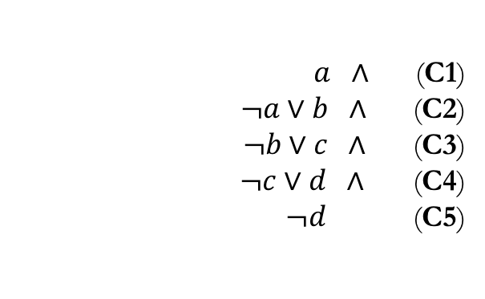
The Maximum Satisfiability Problem
MaxSAT:
$a ∧$(C1)
$¬a∨b ∧$(C2)
1 $¬b∨c ∧$(C3)
2 $¬c∨d ∧$ (C4)
3 $¬d$(C5)

Slide 6
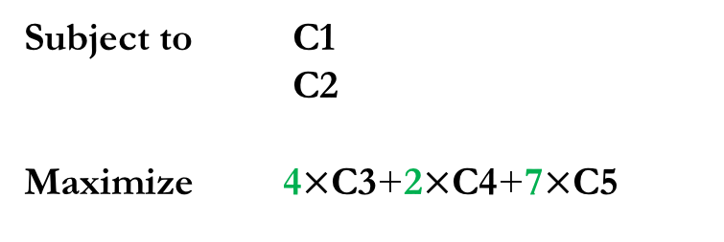
The Maximum Satisfiability Problem
MaxSAT:
$a ∧$(C1)
$¬a∨b ∧$(C2)
1 $¬b∨c ∧$(C3)
2 $¬c∨d ∧$ (C4)
3 $¬d$(C5)
Subject to C1
Subject to C2
Maximize 4$×$C3+2$×$C4+7$×$C5
4:
2:
7:
=
Solution: a = true, b = true, c = true, d = false
(Objective = 11)
Notes:
MaxSAT extends SAT with weights for optimization. There are two kinds of clauses in a MAXSAT problem: hard clauses are standard SAT clauses, while soft clauses are clauses with weights. MAXSAT solver will find a solution that satisfies all the hard clauses, and maximizes the sum of the weights of the soft clauses satisfied.
For the instance on the slide, it has a solution which satisfies all clauses except for C4. As a result, it has an objective of 11.

Slide 7
The Maximum Satisfiability Problem
+ Expressive for our problems
Soundness Conditions
Hard
+
Objectives
Soft
Balancing tradeoffs (e.g., precision vs. scalability)
Handling
uncertainty
(e.g., incorrect
specs)
Modeling
missing data (e.g., partial programs)
…

Slide 8
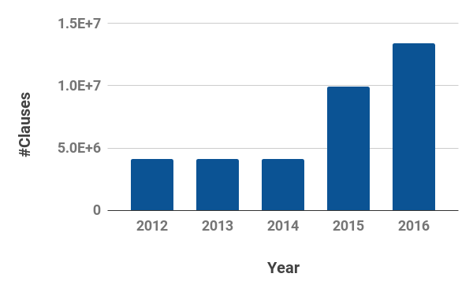
The Maximum Satisfiability Problem
+ Expressive for our problems
+ Efficient (and improving) solvers
Largest instance solved in MaxSAT competition:
13.3M
10.0M
# Clauses
4.1M
Year

Slide 9
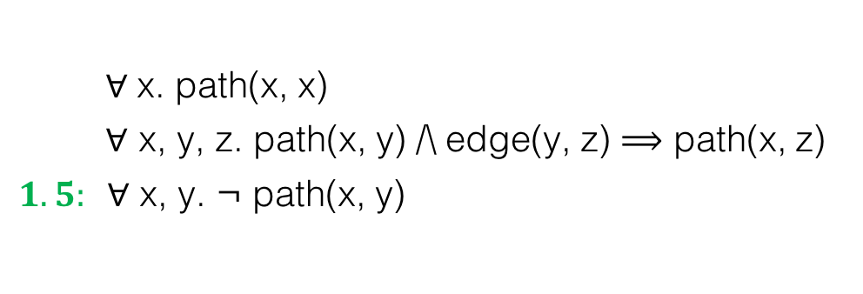
The Maximum Satisfiability Problem
+ Expressive for our problems
+ Efficient (and improving) solvers
$∀$x. path(x, x) $∀$ x, y, z. path(x, y) /\ edge(y, z) $⟹$ path(x, z) $1.5: ∀$ x, y. ¬ path(x, y)
⋀
⋀
− Cannot concisely specify our problems (lacks quantifiers)
− Loses high-level structure that solvers could exploit

Slide 10
The Maximum Satisfiability Problem
+ Expressive for our problems
+ Efficient (and improving) solvers
How to overcome limitations of MaxSAT while retaining its benefits?
$∀$x. path(x, x) $∀$ x, y, z. path(x, y) /\ edge(y, z) $⟹$ path(x, z) $1.5: ∀$ x, y. ¬ path(x, y)
⋀
⋀
A solution: Markov Logic Network (MLN) [Richardson & Domingos, 2006]
− Cannot concisely specify our problems (lacks quantifiers)
− Loses high-level structure that solvers could exploit

Slide 11
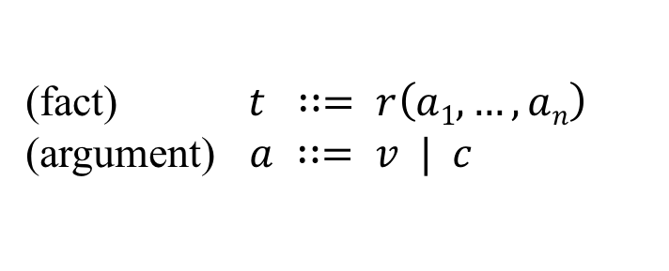
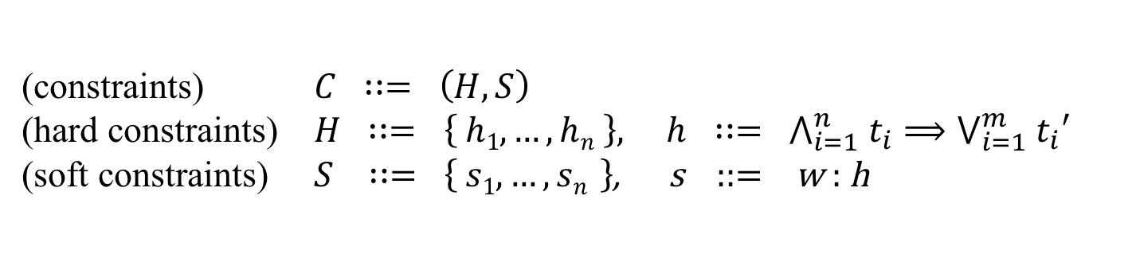

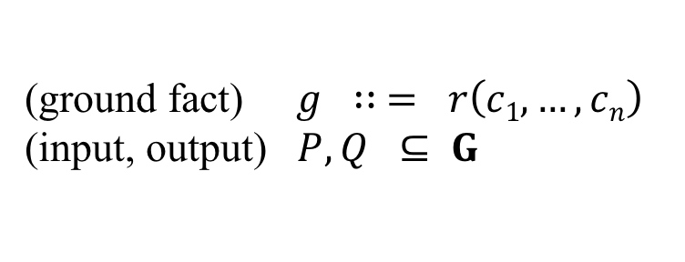
Markov Logic Network: Syntax
(constraints) $C ∷= \left(H, S\right)$
(hard constraints) $H ∷= \left\{ h1, …, hn \right\}, h ∷= ⋀_{i=1}^{n} t_{i}⟹⋁_{i=1}^{m}{ t}_{i}′$
(soft constraints) $S ∷= \left\{ s1, …,sn \right\}$, s ::= w : h
(fact) $t ∷= r\left(a1, …,an\right)$
(argument) $a ∷= v | c$
(ground fact) $g ∷ = r\left(c1, …,cn\right)$
(input, output) $P, Q ⊆ G$
Example:
$∀$x. path(x, x) $∀$ x, y, z. path(x, y) /\ edge(y, z) $⟹$ path(x, z) $1.5: ∀$ x, y. ¬ path(x, y)
⋀
⋀
Notes:
TODO: Put Fig 2 and 3.

Slide 12
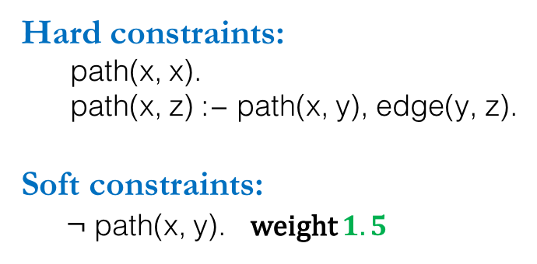
Datalog-like Notation
Input relations:
edge(x, y)
Output relations:
path(x, y)
Hard constraints:
path(x, x). path(x, z) :− path(x, y), edge(y, z).
Soft constraints:
¬ path(x, y). weight $1.5$
Example:
$∀$x. path(x, x) $∀$ x, y, z. path(x, y) /\ edge(y, z) $⟹$ path(x, z) $1.5: ∀$ x, y. ¬ path(x, y)
⋀
⋀
Notes:
TODO: Put Fig 2 and 3.

Slide 13
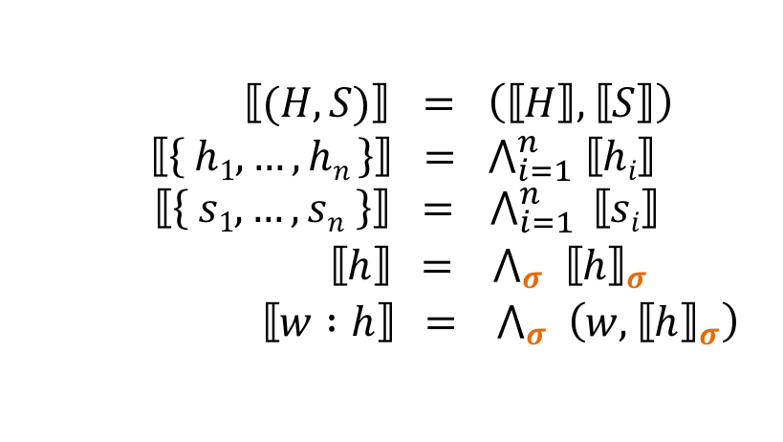
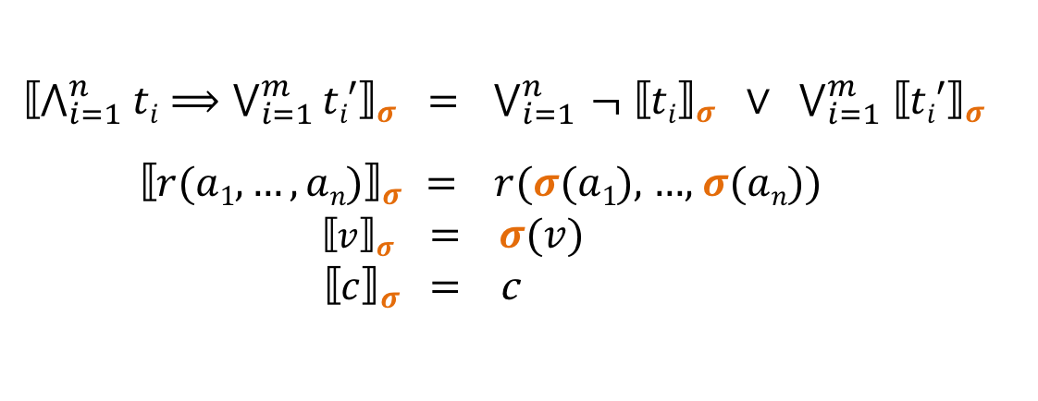
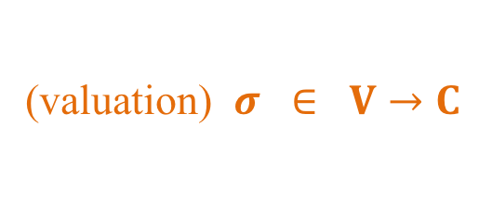
Markov Logic Network: Grounding
(valuation) $σ ∈ V→C$
$⟦(H,S)⟧ = \left(⟦H⟧,⟦S⟧\right)$
$$⟦\left\{ h1, …, hn \right\}⟧ = ⋀_{i=1}^{n} ⟦hi⟧$$
$⟦\left\{ s1, …, sn \right\}⟧ = { ⋀}_{i=1}^{n} ⟦si⟧$
$⟦h⟧$ = $⋀_{σ}^{} {⟦h⟧}_{σ}$
$⟦w :h⟧$ = $⋀_{σ}^{} \left(w, {⟦h⟧}_{σ}\right)$
$${⟦⋀_{i=1}^{n} ti⟹⋁_{i=1 }^{m}ti′⟧}_{σ} = { ⋁}_{i=1}^{n} ¬ {⟦ti⟧}_{σ} ∨ ⋁_{i=1}^{m} {⟦ti′⟧}_{σ}$$
${⟦r(a1,…,an)⟧}_{σ }$ = $r(σ$($a1$), …, $σ$($an$))
${⟦v⟧}_{σ }$ = $σ$($v$)
${ ⟦c⟧}_{σ}$ = c
Notes:
TODO: Put Fig 2 and 3.

Slide 14
Markov Logic Network: Semantics
Conceptually, two steps:
Step 1: Ground the MLN instance
Substitute quantifiers by all possible valuations to constants, to yield a MaxSAT instance
Step 2: Solve the MaxSAT instance
Using off-the-shelf MaxSAT solver
Challenge: both steps intractable for our problems
MaxSAT instances can comprise upto 10^30 clauses!
Solution: Iterative lazy refinement
Notes:
TODO: Put Fig 2 and 3.

Slide 15
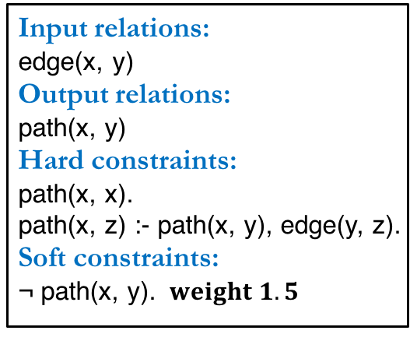
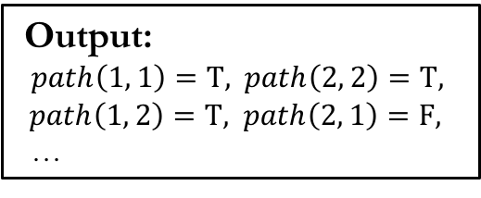
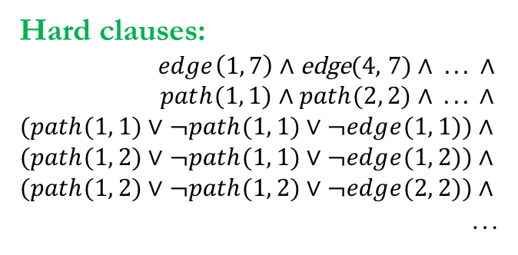
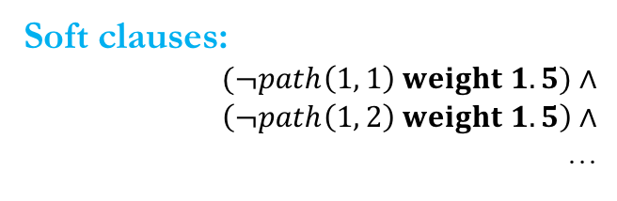
Markov Logic Network: Example
Input relations:
edge(x, y)
Output relations:
path(x, y)
Hard constraints:
path(x, x).
path(x, z) :- path(x, y), edge(y, z).
Soft constraints:
¬ path(x, y). $weight 1.5$
1
4
Input:
edge(1, 7), edge(4, 7), …
7
2
5
8
3
6
Hard clauses:
$edge\left(1, 7\right)∧$ edge(4, 7) $∧ . . . ∧$
$$path(1, \text{1}\text{)}∧path(2, \text{2}\text{)}∧ . . . ∧$$
$$(path(1, \text{1}\text{)}∨¬path(1, \text{1)}∨¬edge(1, 1)\text{)}∧$$
$$(path(1, \text{2}\text{)}∨¬path(1, \text{1}\text{)}∨¬edge(1, 2)\text{)}∧$$
$$(path(1, \text{2}\text{)}∨¬path(1, \text{2}\text{)}∨¬edge(2, 2)\text{)}∧$$
…
Grounding
Output:
$path\left(1, 1\right)=T,$ $path\left(2, 2\right)=T,$
$path\left(1, 2\right)=T,$ $path\left(2, 1\right)=F,$
…
Solving
Soft clauses:
$$(¬path\left(1, 1\right) weight 1.5)∧$$
$$\left(¬path\left(1, 2\right) weight 1.5\right)∧$$
…
Notes:
TODO: Put Fig 2 and 3.

Slide 16
Landscape of Problems
Focus of this Talk
Maximum A Posteriori (MAP) Inference
INFERENCE
Marginal Inference
LEARNING
Weight Learning
Structure Learning
$∀$x. path(x, x) $∀$ x, y, z. path(x, y) /\ edge(y, z) $⟹$ path(x, z) $1.5: ∀$ x, y. ¬ path(x, y)
⋀
⋀

Slide 17
Talk Outline
Background
Part I: Applications in Software Analysis
Part II: Techniques for MaxSAT Solving
Conclusion

Slide 18
Applications in Software Analysis
Abstraction Selection in Automated Verification [PLDI 2014]
Input relations:
edge(a, b)
Output relations:
path(a, b)
Constraints:
1path(a, a).
2path(a, c) :- path(a, b), edge(b, c).
Alarm Classification in Static Bug Detection [FSE 2015]
Alarm Resolution in Interactive Verification [OOPSLA 2017]

Slide 19
Overview of Applications
Abstraction Selection [PLDI 2014]
Alarm Classification [FSE 2015]
Alarm Resolution [OOSPLA 2017]

Slide 20
An Example: Pointer Analysis
f(){
v1 = new ...
v2 = id1(v1)
v3 = id2(v2)
assert(v3 != v1) q1
}
id1(v){ return v }
g(){
v4 = new ...
v5 = id1(v4)
v6 = id2(v5)
assert(v6 != v1) q2
}
id2(v){ return v }
Notes:
In the rest of the talk, I am going to use pointer analysis as an example to illustrate our approach. The example program allocates an object in each of methods f and g, and passes it to methods id1 and id2. The pointer analysis is asked to prove two queries: q1 says that v6 does not alias with v1 at the end of g, while q2 says that v3 does not alias with v1 at the end of f. Proving q1 requires a context sensitive analysis which can distinguish different calling contexts of id1 and id2. Otherwise, the confusion of calling contexts will cause a spurious flow shown on the slide, which will fail the proof of q1. Q2 on the other hand cannot be proven as v3 does alias with v1 .
A standard approach to distinguish between calling contexts is to clone, or inline the called method body at a call site. You might ask why not inline every method call? This is infeasible as it will grow the program size exponentially and make the analysis not terminating with the presence of recursion. To address this problem, our goal is to clone selectively.

Slide 21
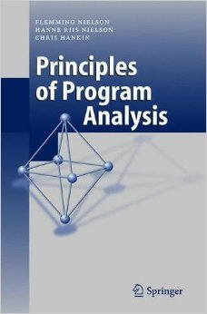

Pointer Analysis via Graph Reachability
1
4
f(){
v1 = new ...
v2 = id1(v1)
v3 = id2(v2)
assert(v3!=v1) q1
}
id1(v){ return v }
g(){
v4 = new ...
v5 = id1(v4)
v6 = id2(v5)
assert(v6!=v1) q2
}
id2(v){ return v }
7
2
5
8
3
6
assert(v6!=v1) holds if there is no path from 1 to 6.
assert(v3!=v1) holds if there is no path from 1 to 3.
Analysis Writer (Alice)
Notes:
TODO: state connection between asserts and queries more clearly

Slide 22
Analysis Specification in Datalog
Input relations: Output relations:
edge(a, b) path(a, b)
Constraints:
path(a, a).
path(a, c) :- path(a, b), edge(b, c).
If there is a path from a to b, and there is an edge from b to c, then there is a path from a to c.
Analysis Writer (Alice)
Notes:
TODO: benefits of declarative do not appear here. Also remember to mention Datalog-specific benefits.

Slide 23


Analysis Evaluation in Datalog
1
4
f(){
v1 = new ...
v2 = id1(v1)
v3 = id2(v2)
assert(v3!=v1) q1
}
id1(v){ return v }
g(){
v4 = new ...
v5 = id1(v4)
v6 = id2(v5)
assert(v6!=v1) q2
}
id2(v){ return v }
7
2
5
8
path(1,1)
edge(1,7)
3
6
edge(7,2)
path(1,7)
edge(7,5)
edge(2,8)
path(1,2)
path(1,5)
edge(5,8)
edge(8,3)
path(1,8)
edge(8,6)
false alarm!
Analysis User (Bob)
path(1,3)
path(1,6)

Slide 24
A More Precise Abstraction
1
4
f(){
v1 = new ...
v2 = id1(v1)
v3 = id2(v2)
assert(v3!=v1) q1
}
id1(v){ return v }
g(){
v4 = new ...
v5 = id1(v4)
v6 = id2(v5)
assert(v6!=v1) q2
}
id2(v){ return v }
7_{f}
7
7_{g}
2
5
8_{f}
8
8_{g}
path(1,1)
edge(1,7)
3
6
edge(7,2)
path(1,7)
edge(7,5)
edge(2,8)
path(1,2)
path(1,5)
edge(5,8)
edge(8,3)
path(1,8)
edge(8,6)
false alarm!
Analysis User (Bob)
path(1,3)
path(1,6)
Notes:
TODO: replace q1 and q2 in image

Slide 25

A More Precise Abstraction
1
4
f(){
v1 = new ...
v2 = id1(v1)
v3 = id2(v2)
assert(v3!=v1) q1
}
id1(v){ return v }
g(){
v4 = new ...
v5 = id1(v4)
v6 = id2(v5)
assert(v6!=v1) q2
}
id2(v){ return v }
7_{f}
7
7_{g}
2
5
8_{f}
8
8_{g}
path(1,1)
edge(1,7_{f})
3
6
edge(7_{f},2)
path(1,7_{f})
edge(7_{g},5)
edge(2,8_{f})
path(1,2)
path(1,5)
edge(5,8_{g})
edge(8_{f},3)
path(1,8_{f})
edge(8_{g},6)
false alarm!
Analysis User (Bob)
path(1,3)
path(1,6)
Notes:
TODO: replace q1 and q2 in image

Slide 26
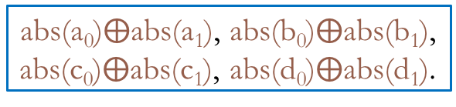
Abstraction Refinement
Input relations: Output relations:
edge(a, b), abs(n) path(a, b)
Constraints:
path(a, a).
path(a, c) :- path(a, b), edge(b, c, n), abs(n).
a₁
1
a₀
b₀
4
b₁
Input relations: Output relations:
edge(a, b) path(a, b)
Constraints:
path(a, a).
path(a, c) :- path(a, b), edge(b, c).
7_{f}
7
7_{g}
a₁
a₀
b₀
b₁
c₁
2
5
c₀
d₀
d₁
8_{f}
8
8_{g}
abs(a₀)$⨁$abs(a₁), abs(b₀)$⨁$abs(b₁),
abs(c₀)$⨁$abs(c₁), abs(d₀)$⨁$abs(d₁).
c₁
c₀
d₀
d₁
3
6
16 possible abstractions in total
Query Tuple | Original Query
q₁: path(1, 3) | assert(v3!=v1)
q₂: path(1, 6) | assert(v6!=v1)
Notes:
TODO: possibly change order of animation
We express the graph reachability problem in Datalog. Input relation edge represents the possible edges in the graph. The correspondent input tuples are fixed.
Relation abs is the program abstraction. It specifies what edges may be used in computing graph reachability. The correspondent input tuples are configurable. For any edge pair like a0 or a1, we can either choose a0 or a1. Choosing a1 over a0 will produce a more precise but more expensive abstraction, as it means to clone the method. There’re 16 possible such abstractions in total.
The only output relation is the path relation, which represents graph reachability. Proving q1 becomes to show path(0, 5) is not derived under certain abstraction while q2 becomes to show path(0, 2) is not derived under certain abstraction.
There’re two rules. Rule 1 states that each node is reachable from itself. Rule 2 states that Node j is reachable from Node i if node k is reachable from Node i and edge(k, j) is allowed in the abstraction.

Slide 27
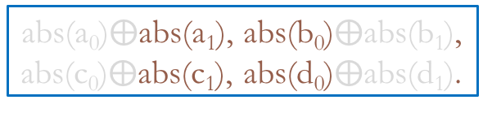
Desired Result
a₁
1
a₀
b₀
4
b₁
Input relations: Output relations:
edge(a, b), abs(n) path(a, b)
Constraints:
path(a, a).
path(a, c) :- path(a, b), edge(b, c, n), abs(n).
7_{f}
7
7_{g}
a₁
a₀
b₀
b₁
c₁
2
5
c₀
d₀
d₁
8_{f}
8
8_{g}
abs(a₀)$⨁$abs(a₁), abs(b₀)$⨁$abs(b₁),
abs(c₀)$⨁$abs(c₁), abs(d₀)$⨁$abs(d₁).
c₁
c₀
d₀
d₁
3
6
Query | Answer
q₁: path(1, 3) | Impossibility
q₂: path(1, 6) | a₁b₀c₁d₀
Notes:
It turns out that q1 is provable with the cheapest abstraction a1b0c1d0, while q2 is impossible to prove. Our goal is to find such cheapest abstraction for q1 and conclude q2 is impossible to prove.

Slide 28
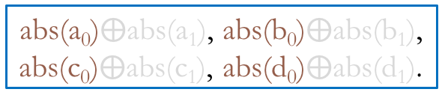
Iteration 1
a₁
1
a₀
b₀
4
b₁
Input relations: Output relations:
edge(a, b), abs(n) path(a, b)
Constraints:
path(a, a).
path(a, c) :- path(a, b), edge(b, c, n), abs(n).
7_{f}
7
7_{g}
a₁
a₀
b₀
b₁
c₁
2
5
c₀
d₀
d₁
8_{f}
8
8_{g}
abs(a₀)$⨁$abs(a₁), abs(b₀)$⨁$abs(b₁),
abs(c₀)$⨁$abs(c₁), abs(d₀)$⨁$abs(d₁).
c₁
c₀
d₀
d₁
3
6
Query | Eliminated Abstractions
q₁: path(1, 3)
q₂: path(1, 6)
Notes:
Same as a standard CEGAR approach, our approach starts with the cheapest abstraction in the space, which is a0b0c0d0, meaning no cloning at all. We fail to prove both queries as both tuples are derived.
We try to learn from counterexamples and avoid similar failures in the future. But what is a counterexample for Datalog programs?

Slide 29
Iteration 1 - Derivation Graph
path(1,1)
edge(1,7,a₀)
abs(a₀)
abs(a₀)
edge(7,2,a₀)
path(1,7)
edge(7,5,b₀)
abs(b₀)
abs(c₀)
edge(2,8,c₀)
path(1,2)
path(1,5)
edge(5,8,d₀)
abs(d₀)
abs(c₀)
edge(8,3,c₀)
path(1,8)
edge(8,6,d₀)
abs(d₀)
path(1,3)
path(1,6)
Notes:
Let us take a closer look at the derivation graph.

Slide 30
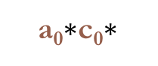
Iteration 1 - Derivation Graph
path(1,1)
edge(1,7,a₀)
abs(a₀)
abs(a₀)
edge(7,2,a₀)
path(1,7)
edge(7,5,b₀)
abs(b₀)
abs(c₀)
edge(2,8,c₀)
path(1,2)
path(1,5)
edge(5,8,d₀)
abs(d₀)
abs(c₀)
edge(8,3,c₀)
path(1,8)
edge(8,6,d₀)
abs(d₀)
path(1,3)
path(1,6)
a₀$∗$c₀$∗$
Notes:
We can observe that, as long as we have a0 and c0 in the abstraction, path(0, 2) will be derived.

Slide 31
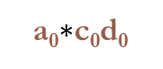
Iteration 1 - Derivation Graph
path(1,1)
edge(1,7,a₀)
abs(a₀)
abs(a₀)
edge(7,2,a₀)
path(1,7)
edge(7,5,b₀)
abs(b₀)
abs(c₀)
edge(2,8,c₀)
path(1,2)
path(1,5)
edge(5,8,d₀)
abs(d₀)
abs(c₀)
edge(8,3,c₀)
path(1,8)
edge(8,6,d₀)
abs(d₀)
path(1,3)
path(1,6)
a₀$∗$c₀$\text{d}\text{0}$
Notes:
For path(0, 5), as long as we have a0c0d0

Slide 32
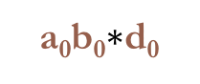
Iteration 1 - Derivation Graph
path(1,1)
edge(1,7,a₀)
abs(a₀)
abs(a₀)
edge(7,2,a₀)
path(1,7)
edge(7,5,b₀)
abs(b₀)
abs(c₀)
edge(2,8,c₀)
path(1,2)
path(1,5)
edge(5,8,d₀)
abs(d₀)
abs(c₀)
edge(8,3,c₀)
path(1,8)
edge(8,6,d₀)
abs(d₀)
path(1,3)
path(1,6)
a₀b₀$∗$d₀
Notes:
Or a0b0d0, it will be derived.
Put eliminated abstractions below

Slide 33
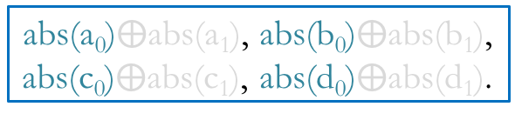
Iteration 1 - Derivation Graph
a₁
1
a₀
b₀
4
b₁
7_{f}
7
7_{g}
a₁
a₀
b₀
b₁
c₁
2
5
c₀
d₀
d₁
8_{f}
8
8_{g}
c₁
c₀
d₀
d₁
3
6
Query | Eliminated Abstractions
q₁: path(1, 3) | a₀*c₀* (4/16)
q₂: path(1, 6) | a₀*c₀d₀, a₀b₀*d₀ (3/16)
abs(a₀)$⨁$abs(a₁), abs(b₀)$⨁$abs(b₁),
abs(c₀)$⨁$abs(c₁), abs(d₀)$⨁$abs(d₁).
Notes:
Therefore, we eliminate four abstractions for each queries.
Our next step should be find the cheapest abstraction avoiding all existing counterexamples. How do we do this?

Slide 34
Encoding in MaxSAT
abs(a₀)$⨁$abs(a₁), abs(b₀)$⨁$abs(b₁),
abs(c₀)$⨁$abs(c₁), abs(d₀)$⨁$abs(d₁).
Notes:
We encode the derivation graph as the hard constraints. Each grounded Datalog rules is translated into a Horn clause. We use the tuple itself as the boolean variable, representing the existence of the tuple in the derivation. The constraints regarding derivation graph have to be hard as they explain why each tuple is derived. This is related with the soundness of the Datalog analysis.
There are two kinds of soft constraints. The first kind of soft constraints encodes the cost of abstraction. The higher weight, the cheaper the abstraction is. For example, we assign weight 1 to a0, which means if we have a0 in the abstraction, we gain a Score 1. If we have abs(a0) = false, which means we don’t have a0 but a1 in the abstraction. In this case, we get a score of 0, explicitly. ( too low-level) (mention cloning again)
The second kind of soft constraints are about queries. We use the negation of the query tuple to express that we want to get rid of them. You might wonder why we encode query tuples as soft constraints rather than hard constraints. This is because no matter what abstraction we choose, q2 cannot be proven. If we encode it as a hard constraint, it will make the whole formula unsatisfiable, preventing the proof of the other query.
You may further wonder why we use 5 as the weight for the queries. We use 5, which is greater than the highest sum of weight of all abstractions, that is 4. Therefore, when this constraint is violated, it means no abstraction in the space can prove this query, even with the most expensive abstraction.

Slide 35
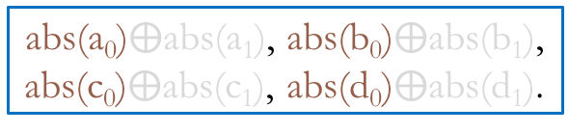
Encoding in MaxSAT
abs(a₀)$⨁$abs(a₁), abs(b₀)$⨁$abs(b₁),
abs(c₀)$⨁$abs(c₁), abs(d₀)$⨁$abs(d₁).

Slide 36
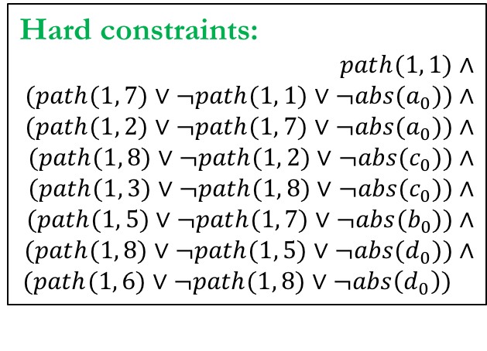
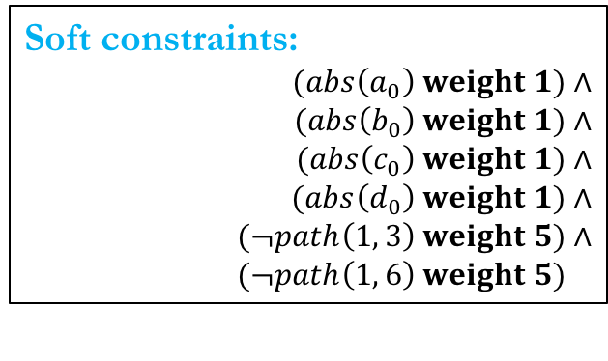
Encoding in MaxSAT
Avoid all the counterexamples
Hard constraints:
$$path(1, 1\text{)}∧$$
$$(path(1, \text{7}\text{)}∨¬path(1, \text{1)}∨¬abs(a_{0})\text{)}∧$$
$$(path(1, \text{2}\text{)}∨¬path(1, \text{7}\text{)}∨¬abs(a_{0})\text{)}∧$$
$$(path(1, \text{8}\text{)}∨¬path(1, \text{2}\text{)}∨¬abs(c_{0})\text{)}∧$$
$$(path(1, \text{3}\text{)}∨¬path(1, \text{8}\text{)}∨¬abs(c_{0})\text{)}∧$$
$$(path(1, \text{5}\text{)}∨¬path(1, \text{7}\text{)}∨¬abs(b_{0})\text{)}∧$$
$$(path(1, \text{8}\text{)}∨¬path(1, \text{5}\text{)}∨¬abs(d_{0})\text{)}∧$$
$$(path(1, \text{6}\text{)}∨¬path(1, \text{8}\text{)}∨¬abs\left(d_{0}\right)\text{)}$$
Minimize the abstraction cost
Soft constraints:
$$(abs\left(a_{0}\right) weight 1)∧$$
$$(abs\left(b_{0}\right) weight 1)∧$$
$$(abs\left(c_{0}\right) weight 1)∧$$
$$(abs\left(d_{0}\right) weight 1)∧$$
$$(¬path\left(1, 3\right) weight 5)∧$$
$$(¬path\left(1, 6\right) weight 5)∧$$
abs(a₀)$⨁$abs(a₁), abs(b₀)$⨁$abs(b₁),
abs(c₀)$⨁$abs(c₁), abs(d₀)$⨁$abs(d₁).
Notes:
We encode the derivation graph as the hard constraints. Each grounded Datalog rules is translated into a Horn clause. We use the tuple itself as the boolean variable, representing the existence of the tuple in the derivation. The constraints regarding derivation graph have to be hard as they explain why each tuple is derived. This is related with the soundness of the Datalog analysis.
There are two kinds of soft constraints. The first kind of soft constraints encodes the cost of abstraction. The higher weight, the cheaper the abstraction is. For example, we assign weight 1 to a0, which means if we have a0 in the abstraction, we gain a Score 1. If we have abs(a0) = false, which means we don’t have a0 but a1 in the abstraction. In this case, we get a score of 0, explicitly. ( too low-level) (mention cloning again)
The second kind of soft constraints are about queries. We use the negation of the query tuple to express that we want to get rid of them. You might wonder why we encode query tuples as soft constraints rather than hard constraints. This is because no matter what abstraction we choose, q2 cannot be proven. If we encode it as a hard constraint, it will make the whole formula unsatisfiable, preventing the proof of the other query.
You may further wonder why we use 5 as the weight for the queries. We use 5, which is greater than the highest sum of weight of all abstractions, that is 4. Therefore, when this constraint is violated, it means no abstraction in the space can prove this query, even with the most expensive abstraction.

Slide 37
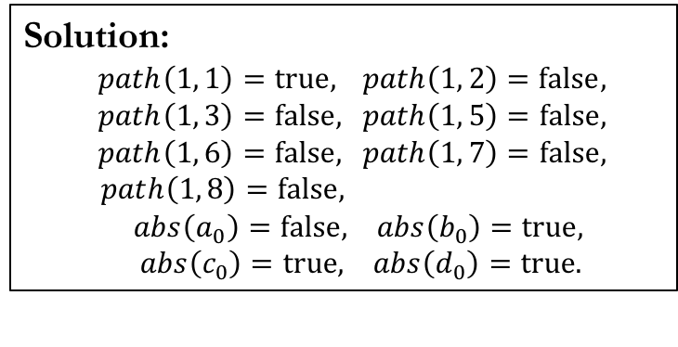
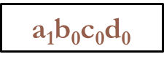
Encoding in MaxSAT
Solution:
$path\left(1, 1\right)=true,$ $path\left(1, 2\right)=false,$
$path\left(1, 3\right)=false,$ $path\left(1, 5\right)=false,$
$path\left(1, 6\right)=false,$ $path\left(1, 7\right)=false,$
$path\left(1, 8\right)=false, p,ath\left(0, 6\right)= 0,abs\left(a_{0}\right)=false, abs\left(b_{0}\right)=true,$
$abs\left(c_{0}\right)=true, abs\left(d_{0}\right)=true.$
Hard constraints:
$$path(1, 1\text{)}∧$$
$$(path(1, \text{7}\text{)}∨¬path(1, \text{1)}∨¬abs(a_{0})\text{)}∧$$
$$(path(1, \text{2}\text{)}∨¬path(1, \text{7}\text{)}∨¬abs(a_{0})\text{)}∧$$
$$(path(1, \text{8}\text{)}∨¬path(1, \text{2}\text{)}∨¬abs(c_{0})\text{)}∧$$
$$(path(1, \text{3}\text{)}∨¬path(1, \text{8}\text{)}∨¬abs(c_{0})\text{)}∧$$
$$(path(1, \text{5}\text{)}∨¬path(1, \text{7}\text{)}∨¬abs(b_{0})\text{)}∧$$
$$(path(1, \text{8}\text{)}∨¬path(1, \text{5}\text{)}∨¬abs(d_{0})\text{)}∧$$
$$(path(1, \text{6}\text{)}∨¬path(1, \text{8}\text{)}∨¬abs\left(d_{0}\right)\text{)}$$
a₁$\text{b}\text{0}$c₀d₀
Soft constraints:
$$(abs\left(a_{0}\right) weight 1)∧$$
$$(abs\left(b_{0}\right) weight 1)∧$$
$$(abs\left(c_{0}\right) weight 1)∧$$
$$(abs\left(d_{0}\right) weight 1)∧$$
$$(¬path\left(1, 3\right) weight 5)∧$$
$$(¬path\left(1, 6\right) weight 5)∧$$
Query | Eliminated Abstractions
q₁: path(1, 3) | a₀*c₀* (4/16)
q₂: path(1, 6) | a₀*c₀d₀, a₀b₀*d₀ (3/16)
Notes:
MAXST solve produces the solution shown on the slides. The solutions suggests flipping a0 to a1 while keeping all the other abstraction tuples.. This yields a1b0c0d0 to be the next abstraction to try. This abstraction is the cheapest abstraction among the viable abstractions left.

Slide 38




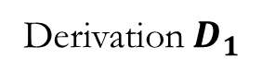
Iteration 2 and Beyond
Iteration 1
Derivation${ D}_{1}$
MaxSAT solver
Datalog solver
$$\text{Constraint}\text{s}$$
$$C_{1}$$
$$C_{1}∧$$
a₁$\text{b}\text{0}$c₀d₀
Query | Answer | Eliminated Abstractions
q₁: path(1, 3) |  | a₀*c₀* (4/16)
q₂: path(1, 6) |  | a₀*c₀d₀, a₀b₀*d₀ a (3/16)
Notes:
After the first iteration, we eliminate 4 abstractions for each query, and use a1b0c0d0 as the next abstraction to try.

Slide 39
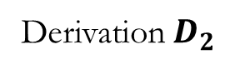
Iteration 2 and Beyond
Iteration 2
Derivation${ D}_{2}$
MaxSAT solver
Datalog solver
$$\text{Constraint}\text{s}$$
$$C_{1}$$
$$C_{1}∧$$
a₁$\text{b}\text{0}$c₀d₀
Query | Answer | Eliminated Abstractions
q₁: path(1, 3) |  | a₀*c₀* (4/16)
q₂: path(1, 6) |  | a₀*c₀d₀, a₀b₀*d₀ a (3/16)
Notes:
In the second iteration, q1 and q2 are still unproven as both tuples are derived. We get another derivation D2 and pass it to the MAXSAT solver.

Slide 40
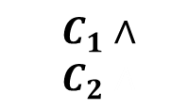
Iteration 2 and Beyond
Iteration 2
Derivation${ D}_{2}$
MaxSAT solver
Datalog solver
$$\text{Constraint}\text{s}$$
$$C_{1}$$
$$C_{1}∧$$
$$C_{2}∧$$
a₁$\text{b}\text{0}$c₀d₀
Query | Answer | Eliminated Abstractions
q₁: path(1, 3) |  | a₀*c₀* (4/16)
q₂: path(1, 6) |  | a₀*c₀d₀, a₀b₀*d₀ a (3/16)
Notes:
MAXSAT encodes D2 as constraints C2

Slide 41
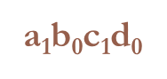
Iteration 2 and Beyond
Iteration 2
Derivation${ D}_{2}$
MaxSAT solver
Datalog solver
$$\text{Constraint}\text{s}$$
$$C_{1}$$
$$C_{1}∧$$
$$C_{2}∧$$
a₁$\text{b}\text{0}$c₁d₀
Query | Answer | Eliminated Abstractions
q₁: path(1, 3) |  | a₀*c₀*, a₁*c₀* (8/16)
q₂: path(1, 6) |  | a₀*c₀d₀, a₀b₀*d₀, a₁*c₀d₀ a (5/16)
Notes:
By taking the conjunction of C2 and C1 coming from the first iteration, the MAXSAT eliminates 6 abstractions for q1, and 8 abstractions for q2. It produces a1b0c1d0 as the abstraction for the third iteration.

Slide 42
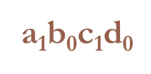
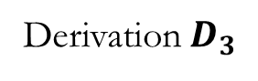
Iteration 2 and Beyond
Iteration 3
Derivation${ D}_{3}$
MaxSAT solver
Datalog solver
$$\text{Constraint}\text{s}$$
$$C_{1}$$
$$C_{1}∧$$
$$C_{2}∧$$
q₂ is proven.
a₁$\text{b}\text{0}$c₁d₀
Query | Answer | Eliminated Abstractions
q₁: path(1, 3) |  | a₀*c₀*, a₁*c₀* (8/16)
q₂: path(1, 6) |  | a₀*c₀d₀, a₀b₀*d₀, a₁*c₀d₀ a (5/16)
a₁$\text{b}\text{0}$c₁d₀
Notes:
In the third iteration, q1 is proven as path(0, 5) is no longer derived. Therefore we find the cheapest abstraction to prove q1, which is a1b0c1d0.

Slide 43
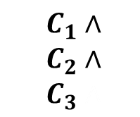
Iteration 2 and Beyond
Iteration 3
Derivation${ D}_{3}$
MaxSAT solver
Datalog solver
$$\text{Constraint}\text{s}$$
$$C_{1}$$
$$C_{1}∧$$
$$C_{2}∧$$
$$C_{3}∧$$
q₂ is proven.
a₁$\text{b}\text{0}$c₁d₀
Query | Answer | Eliminated Abstractions
q₁: path(1, 3) |  | a₀*c₀*, a₁*c₀* (8/16)
q₂: path(1, 6) |  | a₀*c₀d₀, a₀b₀*d₀, a₁*c₀d₀ a (5/16)
a₁$\text{b}\text{0}$c₁d₀
Notes:
Q2 is still derived. We encode the derivation D3 as constraint C3 and pass it to the MAXSAT solver. By taking the conjunction of all the constraints across iterations, MAXSAT eliminates all the 16 abstractions for q2, and conclude q2 is impossible to prove.

Slide 44
Iteration 2 and Beyond
Iteration 3
Derivation${ D}_{3}$
MaxSAT solver
Datalog solver
$$\text{Constraint}\text{s}$$
$$C_{1}$$
$$C_{1}∧$$
$$C_{2}∧$$
$$C_{3}∧$$
q₂ is proven.
q₁ is impossible to prove.
a₁$\text{b}\text{0}$c₁d₀
Query | Answer | Eliminated Abstractions
q₁: path(1, 3) |  | a₀*c₀*, a₁*c₀*, a₀*c₁*, a₁*c₁* (16/16)
q₂: path(1, 6) |  | a₀*c₀d₀, a₀b₀*d₀, a₁*c₀d₀ a (5/16)
Impossibility
a₁$\text{b}\text{0}$c₁d₀
Notes:
Q2 is still derived. We encode the derivation D3 as constraint C3 and pass it to the MAXSAT solver. By taking the conjunction of all the constraints across iterations, MAXSAT eliminates all the 16 abstractions for q2, and conclude q2 is impossible to prove.

Slide 45
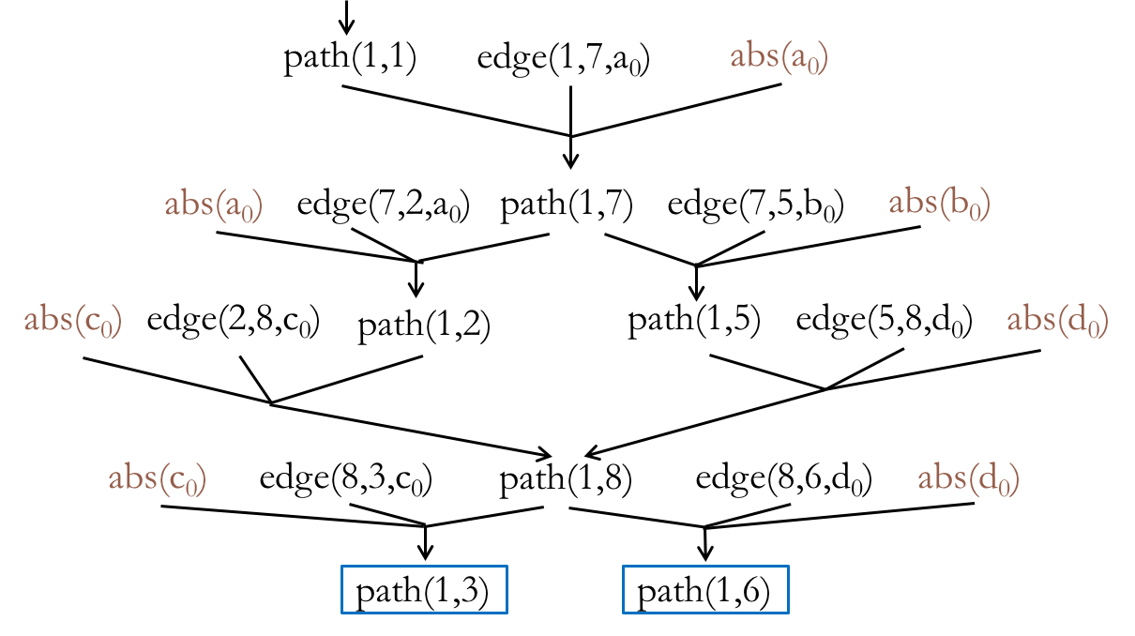
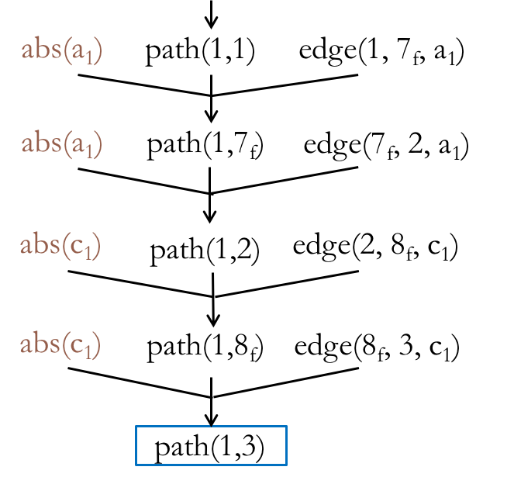


Mixing Counterexamples
Iteration 1
Iteration 3
Eliminated
Abstractions:
a₀$∗$c₀$∗$
a₁$∗$c₁$∗$
Notes:
If we take a closer look at the progress of resolving q2. Iteration 1 eliminates 4 abstractions while Iteration 3 eliminates 4 different abstractions. We notice that the two derivations share the same intermediate tuple path(0, 1). When MAXSAT solver takes the conjunction of two derivations, something interesting happens.

Slide 46
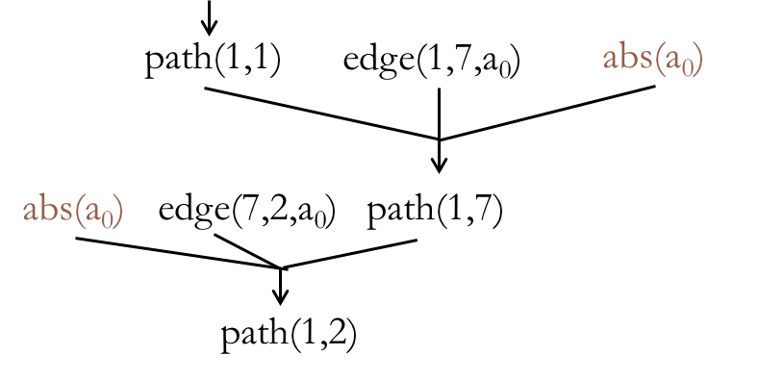
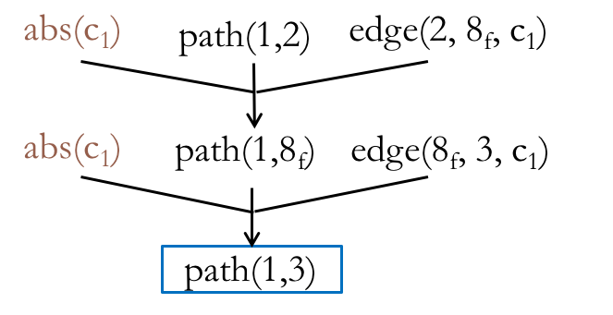

Mixing Counterexamples
Iteration 1
Mixed!
Iteration 3
Eliminated
Abstractions:
a₀$∗$c₀$∗$
a₀$∗$c₁$∗$
a₁$∗$c₁$∗$
Notes:
If we take a closer look at the progress of resolving q2. Iteration 1 eliminates 4 abstractions while Iteration 3 eliminates 4 different abstractions. We notice that the two derivations share the same intermediate tuple path(0, 1). When MAXSAT solver takes the conjunction of two derivations, something interesting happens.

Slide 47
Experimental Setup
Implemented using off-the-shelf solvers
Datalog: bddbddb
MaxSAT: MiFuMaX
Applied to two analyses that are challenging to scale
k-object-sensitive pointer analysis
flow-insensitive, weak updates, cloning-based
type-state analysis
flow-sensitive, strong updates, summary-based
Evaluated on 8 Java programs (250-450 KLOC each)
76 rules, 50 input relations, 42 output relations
52 rules, 33 input relations, 14 output relations
Notes:
We have implemented our approach in the Jchord program analysis framework for Java. Our implementation uses unmodified, off-the-shelf Datalog and MAXSAT solvers. We applied the approach to two client analyses that are challenging to scale: one is a k-obj pointer analysis and the other is a typestate analysis.
These two analyses differ in many aspects such as flow sensitivity, heap updates, and context sensitivity.
These differences highlight the generality of our approach.
We applied these two analyses to 8 real-world Java programs, mostly from DaCapo suite and Ashes Suite.

Slide 48
Pointer Analysis Results
4-object-sensitivity < 50%
< 3% of max
 | queries |  |  | abstraction size |  | iterations
 | total | resolved
 |  | current | baseline | final | max
toba-s | 7 | 7 | 0 | 170 | 18K | 10
javasrc-p | 46 | 46 | 0 | 470 | 18K | 13
weblech | 5 | 5 | 2 | 140 | 31K | 10
hedc | 47 | 47 | 6 | 730 | 29K | 18
antlr | 143 | 143 | 5 | 970 | 29K | 15
luindex | 138 | 138 | 67 | 1K | 40K | 26
lusearch | 322 | 322 | 29 | 1K | 39K | 17
schroeder-m | 51 | 51 | 25 | 450 | 58K | 15
Notes:
The “resolved” column shows the number of queries either proven or found to be impossible to prove. Our approach resolves all the queries while, the baseline, the 4-object-sensitivity analysis, only resolves up to 50% of the queries.
The “final” column shows the sizes of abstractions our approach uses in the last iteration. One way to view the size of the abstraction is to view it as the number of 1s in the abstraction bitvector. “max” shows the size of the most expensive abstraction. As shown on the slide, the size of the final abstraction our approach uses is less than 3% of that of the most expensive abstraction.
Animation on click 1: baseline resolves only upto X% queries
Animation on click 2 for final vs. max abstraction size (pop up)
State that we indeed go to 0.5MLOC with k =10

Slide 49
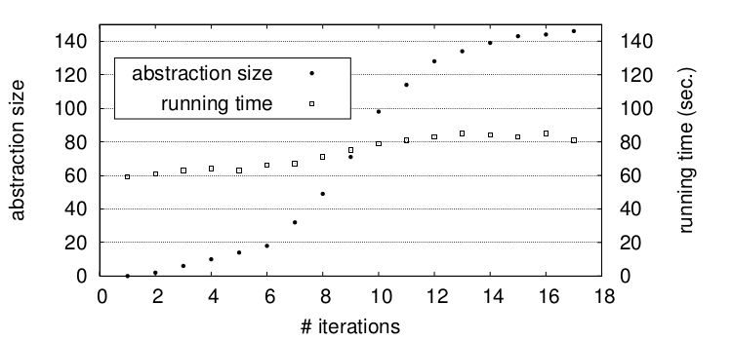
Performance of Datalog Solver
k = 4, 3h28m
Baseline
k = 3, 590s
k = 2, 214s
lusearch
k = 1, 153s
Notes:
This slide shows how the abstraction size and the datalog solver running time change across iterations on benchmark lusearch, The rest benchmarks look similar.
(Remove the following paragraph?)
The x axis is the number of iterations. This curve (use pointer) shows the abstraction size corresponding to the y axis on the left, while this curve (use pointer) shows the datalog running time corresponding to the y axis on the right.
Although the abstraction size grows linearly across iterations, the running time of the datalog solver remains almost constant. This is because by selectively cloning the call sites and allocation sites, our approach increases the abstraction cost by minimum amount required to prove the queries. On the other hand, the baseline, which uses a uniform k value, increases the Datalog running time exponentially.

Slide 50
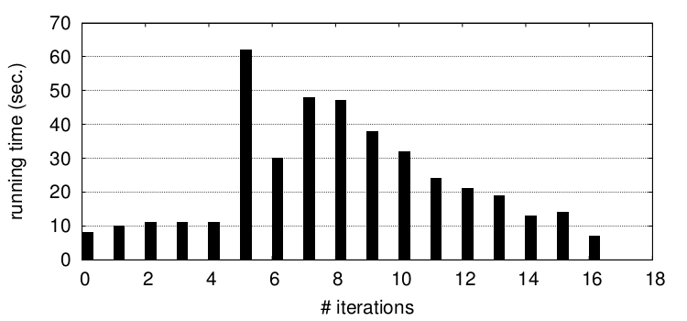
Performance of MaxSAT Solver
lusearch
Notes:
This slide shows the running time of the maxsat solver in each iteration for the lusearch benchmark.
[Animation on click: Blue Up Arrow] We see that in the initial iterations, the running time steadily increases -> constraints harder to solve -> abstraction size gets larger and larger.
[Animation on click: Blue Down Arrow] But in the later iterations, the running time steadily decreases -> constraints easier to solve -> fewer and fewer queries remain

Slide 51
Statistics of MaxSAT Formulae
 | pointer analysis
 | variables | clauses
toba-s | 0.7M | 1.5M
javasrc-p | 0.5M | 0.9M
weblech | 1.6M | 3.3M
hedc | 1.2M | 2.7M
antlr | 3.6M | 6.9M
luindex | 2.4M | 5.6M
lusearch | 2.1M | 5.0M
schroeder-m | 6.7M | 23.7M
Notes:
Here are statistics of the formulae fed to the maxsat solver in the last iteration for the pointer analysis on all benchmarks. The number of variables in these formulas ranges from 1M to 7M, and the number of clauses ranges from 1M to 24M. The statistics look similar for typestate analysis. These numbers highlight two strengths of our technique: the richness of the abstraction search space it explores, and the benefit of leveraging off-the-shelf maxsat solvers.

Slide 52
Overview of Applications
Abstraction Selection [PLDI 2014]
Alarm Classification [FSE 2015]
Alarm Resolution [OOSPLA 2017]

Slide 53
How Do We Go From This …

Slide 54

… To This?

Slide 55
… To This?

Slide 56
An Example: Static Datarace Analysis
Input relations:
next(p1, p2), mayAlias(p1, p2), guarded(p1, p2)
Output relations:
parallel(p1, p2), race(p1, p2)
Constraints:
parallel(p3, p2) :- parallel(p1, p2), next(p3, p1).
(2) parallel(p1, p2) :- parallel(p2, p1).
race(p1, p2) :- parallel(p1, p2), mayAlias(p1, p2), ¬guarded(p1, p2).
…
Notes:
Let’s first look at what a conventional analysis looks like. The analysis I am showing is a simplified datarace analysis that is extracted from Jchord. It is specified in a declarative language called “Datalog”, which is very popular for specifying program analyses.
What is Datalog? Datalog is a querying language that originates from the Database community. It is very similar to SQL, except that it supports recursion.
A Datalog program can be divided into three parts: input relations, output relations, and rules.
Relations are used to specify data and are like tables in a Database.
Input relations specify the input data.
There are three input relations for the datarace detector.
All the p’s range over programming points.
The relation next encodes the control-flow graph of the program.
MayAlias contains the pairs of program points that may access the same memory locations.
Guarded contains the pairs of program points that are guarded by the same lock.
Among these three relations, only next is directly computed from the source code.
Both mayAlias and guarded are calculated by the Datalog analysis. For simplicity, we elide the part computing them and treat them as inputs.
Output relations specify the output data.
There are two output relations. Parallel contains the pairs of program points that can be reached by different threads at the same time.
Datarace contains the final bug reports.
The logic of a Datalog program is specified by its rules.
All rules are deductive, meaning they represent “if something, then something”.
For instance, the first rule says, if p1 and p2 may happen in parallel, and p3 is a successor of p1, then p3 and p2 can happen in parallel.
The second rule says the parallel relation is commutative.
The last rule specifies the Datarace condition: For a given pair of program points p1, p2, if they may happen in parallel, and they may access the same memory location, then there can be a potential datarace between p1 and p2.
To compute the output relations, the Datalog solver will keep applying these rules until the output relations don’t change any more. In other words, it computes the least fixpoint of the rules.

Slide 57
An Example: Static Datarace Analysis
program point p1 is immediate successor of p2.
p1 & p2 may access the same memory location.
Input relations:
next(p1, p2), mayAlias(p1, p2), guarded(p1, p2)
Output relations:
parallel(p1, p2), race(p1, p2)
Constraints:
parallel(p3, p2) :- parallel(p1, p2), next(p3, p1).
(2) parallel(p1, p2) :- parallel(p2, p1).
race(p1, p2) :- parallel(p1, p2), mayAlias(p1, p2), ¬guarded(p1, p2).
…
p1 & p2 are guarded by the same lock.
p1 & p2 may happen in parallel.
If p1 & p2 may happen in parallel,
and p3 is successor of p1, then
p3 & p2 may happen in parallel.
p1 & p2 may
have a datarace.
If p2 & p1 may happen in parallel, then p1 & p2 may happen in parallel.
If p1 & p2 may happen in parallel,
and they may access the same memory location, and they are not guarded by the same lock,
then p1 & p2 may have a datarace.
Notes:
Let’s first look at what a conventional analysis looks like. The analysis I am showing is a simplified datarace analysis that is extracted from Jchord. It is specified in a declarative language called “Datalog”, which is very popular for specifying program analyses.
What is Datalog? Datalog is a querying language that originates from the Database community. It is very similar to SQL, except that it supports recursion.
A Datalog program can be divided into three parts: input relations, output relations, and rules.
Relations are used to specify data and are like tables in a Database.
Input relations specify the input data.
There are three input relations for the datarace detector.
All the p’s range over programming points.
The relation next encodes the control-flow graph of the program.
MayAlias contains the pairs of program points that may access the same memory locations.
Guarded contains the pairs of program points that are guarded by the same lock.
Among these three relations, only next is directly computed from the source code.
Both mayAlias and guarded are calculated by the Datalog analysis. For simplicity, we elide the part computing them and treat them as inputs.
Output relations specify the output data.
There are two output relations. Parallel contains the pairs of program points that can be reached by different threads at the same time.
Datarace contains the final bug reports.
The logic of a Datalog program is specified by its rules.
All rules are deductive, meaning they represent “if something, then something”.
For instance, the first rule says, if p1 and p2 may happen in parallel, and p3 is a successor of p1, then p3 and p2 can happen in parallel.
The second rule says the parallel relation is commutative.
The last rule specifies the Datarace condition: For a given pair of program points p1, p2, if they may happen in parallel, and they may access the same memory location, then there can be a potential datarace between p1 and p2.
To compute the output relations, the Datalog solver will keep applying these rules until the output relations don’t change any more. In other words, it computes the least fixpoint of the rules.

Slide 58
An Example: Static Datarace Analysis
Input relations:
next(p1, p2), mayAlias(p1, p2), guarded(p1, p2)
Output relations:
parallel(p1, p2), race(p1, p2)
Constraints:
parallel(p3, p2) :- parallel(p1, p2), next(p3, p1).
(2) parallel(p1, p2) :- parallel(p2, p1).
race(p1, p2) :- parallel(p1, p2), mayAlias(p1, p2), ¬guarded(p1, p2).
…
¬race(x2, x1).
a = 1;
if (a > 2) { // p1
... // p3
}
“Soft” Rule
weight 5
“Hard” Rule
weight 25
Notes:
We attach a weight 5 to it, which is learned from labeled data.
As for the other two rules, we keep them hard as they are fairly precise.
We also add the user feedback as a soft rule.

Slide 59
An Example: Static Datarace Analysis
1 public class RequestHandler {
2 Request request; 3 FtpWriter writer; 4 BufferedReader reader; 5 Socket controlSocket; 6 boolean isConnectionClosed; 7 … 8 public Request getRequest() {
10 }
11 public void close() { 12 synchronized (this) { 13 if (isClosed)
14 return; 15 isClosed = true; 16 }
21 reader.close(); 22 reader = null; 23 controlSocket.close(); 24 controlSocket = null; 25 }
17 request.clear();
18 request = null;
19 writer.close();
9 return request;
20 writer = null;
Source code snippet from Apache FTP Server
Notes:
I am going to use static datarace analysis as an example to explain how we address these two challenges. We study Datarace as it is fundamental to detecting concurrency bugs for programs in this multi-core era. The analysis tool we consider is JChord, a popular static datarace detection tool. This code fragment is taken from a widely-used program, called Apache FTP server.
Class RequestHandler handles incoming FTP requests. Whenever a new request comes, a new object of this class is created. There are a lot of fields in this object, which can be accessed by multiple threads simultaneously. This in turn can lead to potential dataraces.
We mainly look at two methods. Method getRequest() returns the request field. Method close is invoked when the ftp connection is being closed, and cleans up the states of the object.
To prevent dataraces incurred by the cleanup code from Line 17 to Line 24, a flag isClosed is set. And to prevent dataraces on this flag itself, a synchronization block guards the code accessing it. This pattern is called atomic test-and-set idiom.
Let’s see how it works.

Slide 60
An Example: Static Datarace Analysis
1 public class RequestHandler {
2 Request request; 3 FtpWriter writer; 4 BufferedReader reader; 5 Socket controlSocket; 6 boolean isConnectionClosed; 7 … 8 public Request getRequest() {
10 }
11 public void close() { 12 synchronized (this) { 13 if (isClosed)
14 return; 15 isClosed = true; 16 }
21 reader.close(); 22 reader = null; 23 controlSocket.close(); 24 controlSocket = null; 25 }
17 request.clear();
R1
18 request = null;
19 writer.close();
9 return request;
20 writer = null;
Source code snippet from Apache FTP Server
Notes:
In fact, there is only one datarace in this program, which is between Line 9 and line 17.
But JChord reports another four false alarms as it thinks the cleanup code can be executed by different threads simutanouesly.

Slide 61
An Example: Static Datarace Analysis
1 public class RequestHandler {
2 Request request; 3 FtpWriter writer; 4 BufferedReader reader; 5 Socket controlSocket; 6 boolean isConnectionClosed; 7 … 8 public Request getRequest() {
10 }
11 public void close() { 12 synchronized (this) { 13 if (isClosed)
14 return; 15 isClosed = true; 16 }
21 reader.close(); 22 reader = null; 23 controlSocket.close(); 24 controlSocket = null; 25 }
17 request.clear();
R2
18 request = null;
19 writer.close();
R3
9 return request;
20 writer = null;
R4
R5
Source code snippet from Apache FTP Server
Notes:
This in turn leads to four false alarms.
There are four false alarms which are derived because Jchord is not able to reason about the atomic test-and-set idiom and it considers line 11 to line 24 can be executed by different threads at the same time.
This actually reveals a more general observation. Most of the false alarms are the symptoms of very few root causes.
If we can resolve these few root causes, we can eliminate a lot of false alarms. That is exactly what our approach achieves.
Let focus on R2 and R3.

Slide 62
How Does Generalization Work?
…
17 request.clear();// x1
next(x2,x1)
parallel(x1,x1)
18 request = null; // x2
19 writer.close(); // y1
¬guarded(x2, x1)
mayAias(x2,x1)
parallel(x2,x1)
20 writer = null; // y2
…
race(x2,x1)
parallel(x1,x2)
next(x2,x1)
¬race(x2, x1) weight 25
next(y1,x2)
parallel(x2,x2)
parallel(p3, p2) :- parallel(p1, p2),
next (p3, p1). weight 5
parallel(p1, p2) :- parallel(p2, p1).
race(p1, p2) :- parallel(p1, p2), mayAlias(p1, p2),
¬guarded(p1, p2).
…
parallel(y1,x2)
next(y1,x2)
parallel(x2,y1)
parallel(y1,y1)
next(y2,y1)
mayAias(y2,y1)
parallel(y2,y1)
¬guarded(y2, y1)
race(y2,y1)
Notes:
Here is the code fragment that is related to these two reports.
We run the probabilistic analysis on it and get a derivation graph on the right.
All the hyperedges represent the rule instances, where the dotted edges represent soft rule instances, and the solid edges represent hard rule instances.
Here are the two false alarms derived.
Let’s say Bob inspects race(x2,x1) and the source code, and finds it to be a false alarm, he gives negative feedback.
This negative feedback is encoded as a soft rule with weight 25 in the system.
After adding the user feedback, we notice that the subgraph here form a conflict.
Because this rule instance is hard and the user feedback has a higher weight than this soft rule instance has, we choose to violate this soft rule instance.

Slide 63
How Does Generalization Work?
…
17 request.clear();// x1
next(x2,x1)
parallel(x1,x1)
18 request = null; // x2
19 writer.close(); // y1
¬guarded(x2, x1)
mayAias(x2,x1)
parallel(x2,x1)
20 writer = null; // y2
…
race(x2,x1)
parallel(x1,x2)
next(x2,x1)
¬race(x2, x1) weight 25
next(y1,x2)
parallel(x2,x2)
parallel(p3, p2) :- parallel(p1, p2),
next (p3, p1). weight 5
parallel(p1, p2) :- parallel(p2, p1).
race(p1, p2) :- parallel(p1, p2), mayAlias(p1, p2),
¬guarded(p1, p2).
…
parallel(y1,x2)
next(y1,x2)
parallel(x2,y1)
parallel(y1,y1)
next(y2,y1)
mayAias(y2,y1)
parallel(y2,y1)
¬guarded(y2, y1)
race(y2,y1)
Notes:
Look messy. Change to another format.

Slide 64
How Does Generalization Work?
…
17 request.clear();// x1
next(x2,x1)
parallel(x1,x1)
18 request = null; // x2
19 writer.close(); // y1
¬guarded(x2, x1)
mayAias(x2,x1)
parallel(x2,x1)
20 writer = null; // y2
…
race(x2,x1)
parallel(x1,x2)
next(x2,x1)
¬race(x2, x1) weight 25
next(y1,x2)
parallel(x2,x2)
parallel(p3, p2) :- parallel(p1, p2),
next (p3, p1). weight 5
parallel(p1, p2) :- parallel(p2, p1).
race(p1, p2) :- parallel(p1, p2), mayAlias(p1, p2),
¬guarded(p1, p2).
…
parallel(y1,x2)
next(y1,x2)
parallel(x2,y1)
parallel(y1,y1)
next(y2,y1)
mayAias(y2,y1)
parallel(y2,y1)
¬guarded(y2, y1)
race(y2,y1)
Notes:
As a result, both parallel(x2,x1) and race(x2,x1) are eliminated.

Slide 65
How Does Generalization Work?
…
17 request.clear();// x1
next(x2,x1)
parallel(x1,x1)
18 request = null; // x2
19 writer.close(); // y1
¬guarded(x2, x1)
mayAias(x2,x1)
parallel(x2,x1)
20 writer = null; // y2
…
race(x2,x1)
parallel(x1,x2)
next(x2,x1)
¬race(x2, x1) weight 25
next(y1,x2)
parallel(x2,x2)
parallel(p3, p2) :- parallel(p1, p2),
next (p3, p1). weight 5
parallel(p1, p2) :- parallel(p2, p1).
race(p1, p2) :- parallel(p1, p2), mayAlias(p1, p2),
¬guarded(p1, p2).
…
parallel(y1,x2)
next(y1,x2)
parallel(x2,y1)
parallel(y1,y1)
next(y2,y1)
mayAias(y2,y1)
parallel(y2,y1)
¬guarded(y2, y1)
race(y2,y1)
Notes:
At the same time, we have also implicitly encode the least fixpoint semantics of these rules. As a result, all tuples that depend on parallel(x2,x1) will be also eliminated. So we successfully remove the other false alarm race(y2,y1).

Slide 66
Accuracy of Alarm Classification
feedback on 5% reports
338 700
324 119
111 153
1824 2597
79 183
0 10
Notes:
Let’s first look at the precision result, Because the time is limited, I will only talk about the result for Datarace. The result for pointer analysis is similar.
We obtained the result by randomly sampling 5% of the reports to give feedback on.
Each group of bars represents the result on one benchmark, where the orange bar represents the percentage of false alarms that is eliminated by our approach, and blue bar represents the percentage of true alarms that are retained.
The numbers at the top are the absolute numbers of false alarms and true alarms produced by the original analysis.
Because we have made the analysis probabilistic, sometimes we will have some false negatives.
For both bars, the higher, the better.
On average, our approach is able to eliminate 70% of the false alarms by incorporating 5% of the feedback at the cost of introducing 4% false negatives.

Slide 67
Accuracy of Alarm Classification
feedback on 5% reports
338 700
324 119
111 153
1824 2597
79 183
0 10
With only up to 5% feedback, 70% of the false positives are eliminated and 96% of true positives retained.
Notes:
Let’s first look at the precision result, Because the time is limited, I will only talk about the result for Datarace. The result for pointer analysis is similar.
We obtained the result by randomly sampling 5% of the reports to give feedback on.
Each group of bars represents the result on one benchmark, where the orange bar represents the percentage of false alarms that is eliminated by our approach, and blue bar represents the percentage of true alarms that are retained.
The numbers at the top are the absolute numbers of false alarms and true alarms produced by the original analysis.
Because we have made the analysis probabilistic, sometimes we will have some false negatives.
For both bars, the higher, the better.
On average, our approach is able to eliminate 70% of the false alarms by incorporating 5% of the feedback at the cost of introducing 4% false negatives.

Slide 68
Impact of Varying Amount of Feedback
338 false and 700 true reports
false reports eliminated
true reports retained
Notes:
Let’s look at how the result changes if we vary the amount of feedback.
For simplicity, we only show the result on our largest benchmark.
As we can see, as we further increase the amount of feedback, the results continue to improve.
When we provide 20% feedback, 95% of the false alarms are eliminated, and almost all true alarms are retained.

Slide 69
Overview of Applications
Abstraction Selection [PLDI 2014]
Alarm Classification [FSE 2015]
Alarm Resolution [OOSPLA 2017]

Slide 70
Example Revisited: Static Datarace Analysis
1 public class RequestHandler {
2 Request request; 3 FtpWriter writer; 4 BufferedReader reader; 5 Socket controlSocket; 6 boolean isConnectionClosed; 7 … 8 public Request getRequest() {
10 }
11 public void close() { 12 synchronized (this) { 13 if (isClosed)
14 return; 15 isClosed = true; 16 }
21 reader.close(); 22 reader = null; 23 controlSocket.close(); 24 controlSocket = null; 25 }
Can this statement be executed by different threads in parallel?
17 request.clear();
18 request = null;
19 writer.close();
9 return request;
20 writer = null;
Source code snippet from Apache FTP Server
Notes:
I am going to use static datarace analysis as an example to explain how we address these two challenges. We study Datarace as it is fundamental to detecting concurrency bugs for programs in this multi-core era. The analysis tool we consider is JChord, a popular static datarace detection tool. This code fragment is taken from a widely-used program, called Apache FTP server.
Class RequestHandler handles incoming FTP requests. Whenever a new request comes, a new object of this class is created. There are a lot of fields in this object, which can be accessed by multiple threads simultaneously. This in turn can lead to potential dataraces.
We mainly look at two methods. Method getRequest() returns the request field. Method close is invoked when the ftp connection is being closed, and cleans up the states of the object.
To prevent dataraces incurred by the cleanup code from Line 17 to Line 24, a flag isClosed is set. And to prevent dataraces on this flag itself, a synchronization block guards the code accessing it. This pattern is called atomic test-and-set idiom.
Let’s see how it works.

Slide 71
Illustration: Space of Questions
…
17 request.clear();// x1
next(x2,x1)
parallel(x1,x1)
18 request = null; // x2
19 writer.close(); // y1
¬guarded(x2, x1)
mayAias(x2,x1)
parallel(x2,x1)
20 writer = null; // y2
…
race(x2,x1)
parallel(x1,x2)
next(x2,x1)
next(y1,x2)
parallel(x2,x2)
parallel(p3, p2) :- parallel(p1, p2), next (p3, p1).
parallel(p1, p2) :- parallel(p2, p1).
race(p1, p2) :- parallel(p1, p2), mayAlias(p1, p2),
¬guarded(p1, p2).
…
parallel(y1,x2)
next(y1,x2)
parallel(x2,y1)
parallel(y1,y1)
next(y2,y1)
mayAias(y2,y1)
parallel(y2,y1)
¬guarded(y2, y1)
race(y2,y1)
Notes:
As a result, both parallel(x2,x1) and race(x2,x1) are eliminated.

Slide 72
Illustration: Space of Questions
…
17 request.clear();// x1
next(x2,x1)
parallel(x1,x1)
18 request = null; // x2
19 writer.close(); // y1
¬guarded(x2, x1)
mayAias(x2,x1)
parallel(x2,x1)
20 writer = null; // y2
…
race(x2,x1)
parallel(x1,x2)
next(x2,x1)
next(y1,x2)
parallel(x2,x2)
parallel(p3, p2) :- parallel(p1, p2), next (p3, p1).
parallel(p1, p2) :- parallel(p2, p1).
race(p1, p2) :- parallel(p1, p2), mayAlias(p1, p2),
¬guarded(p1, p2).
…
parallel(y1,x2)
next(y1,x2)
parallel(x2,y1)
parallel(y1,y1)
next(y2,y1)
mayAias(y2,y1)
parallel(y2,y1)
¬guarded(y2, y1)
race(y2,y1)
Notes:
As a result, both parallel(x2,x1) and race(x2,x1) are eliminated.

Slide 73
Illustration: Space of Questions
…
17 request.clear();// x1
next(x2,x1)
parallel(x1,x1)
18 request = null; // x2
19 writer.close(); // y1
¬guarded(x2, x1)
mayAias(x2,x1)
parallel(x2,x1)
20 writer = null; // y2
…
race(x2,x1)
parallel(x1,x2)
next(x2,x1)
next(y1,x2)
parallel(x2,x2)
parallel(p3, p2) :- parallel(p1, p2), next (p3, p1).
parallel(p1, p2) :- parallel(p2, p1).
race(p1, p2) :- parallel(p1, p2), mayAlias(p1, p2),
¬guarded(p1, p2).
…
parallel(y1,x2)
next(y1,x2)
parallel(x2,y1)
parallel(y1,y1)
next(y2,y1)
mayAias(y2,y1)
parallel(y2,y1)
¬guarded(y2, y1)
race(y2,y1)
Notes:
As a result, both parallel(x2,x1) and race(x2,x1) are eliminated.

Slide 74
Two Key Objectives
Generalization
Number of Questions << Number of Alarms Resolved
Prioritization
Prioritize Questions Likely to Resolve the Most Alarms

Slide 75
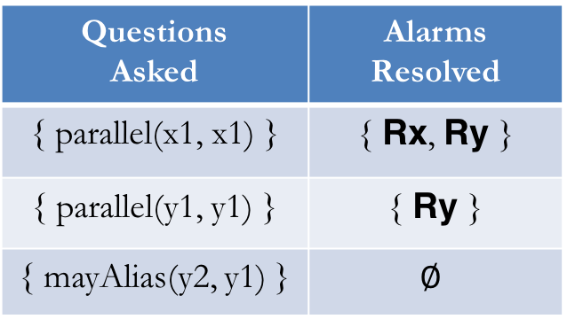
Illustration: Payoff Comparison
…
17 request.clear();// x1
next(x2,x1)
parallel(x1,x1)
18 request = null; // x2
19 writer.close(); // y1
¬guarded(x2, x1)
mayAlias(x2,x1)
parallel(x2,x1)
20 writer = null; // y2
…
Rx
race(x2,x1)
parallel(x1,x2)
next(x2,x1)
next(y1,x2)
parallel(x2,x2)
Questions Asked | Alarms Resolved
{ parallel(x1, x1) } | { Rx, Ry }
{ parallel(y1, y1) } | { Ry }
{ mayAlias(y2, y1) } | $$∅$$
parallel(y1,x2)
next(y1,x2)
parallel(x2,y1)
parallel(y1,y1)
next(y2,y1)
mayAlias(y2,y1)
parallel(y2,y1)
¬guarded(y2, y1)
race(y2,y1)
Ry
Notes:
As a result, both parallel(x2,x1) and race(x2,x1) are eliminated.

Slide 76
Highlights of Overall Approach
Iterative: leverages labels of past questions in choosing future questions
Maximizes the expected payoff in each iteration
Payoff = # Alarms Resolved / # Questions Asked
Non-linear optimization objective
Binary search on payoff by solving sequence of MaxSAT instances
Data-driven: leverages heuristics to guess likely labels
Static, Dynamic, Aggregated

Slide 77
Empirical Results: Generalization
total false and true reports
226
185
64 0
100 0
214 50
594
317
Notes:
Let’s first look at the precision result, Because the time is limited, I will only talk about the result for Datarace. The result for pointer analysis is similar.
We obtained the result by randomly sampling 5% of the reports to give feedback on.
Each group of bars represents the result on one benchmark, where the orange bar represents the percentage of false alarms that is eliminated by our approach, and blue bar represents the percentage of true alarms that are retained.
The numbers at the top are the absolute numbers of false alarms and true alarms produced by the original analysis.
Because we have made the analysis probabilistic, sometimes we will have some false negatives.
For both bars, the higher, the better.
On average, our approach is able to eliminate 70% of the false alarms by incorporating 5% of the feedback at the cost of introducing 4% false negatives.

Slide 78
Empirical Results: Generalization
total false and true reports
226
185
64 0
100 0
214 50
594
317
With only up to 5% questions, 74% of the false alarms are resolved with average payoff of 12X per question.
Notes:
Let’s first look at the precision result, Because the time is limited, I will only talk about the result for Datarace. The result for pointer analysis is similar.
We obtained the result by randomly sampling 5% of the reports to give feedback on.
Each group of bars represents the result on one benchmark, where the orange bar represents the percentage of false alarms that is eliminated by our approach, and blue bar represents the percentage of true alarms that are retained.
The numbers at the top are the absolute numbers of false alarms and true alarms produced by the original analysis.
Because we have made the analysis probabilistic, sometimes we will have some false negatives.
For both bars, the higher, the better.
On average, our approach is able to eliminate 70% of the false alarms by incorporating 5% of the feedback at the cost of introducing 4% false negatives.

Slide 79
Empirical Results: Prioritization
Notes:
Let’s first look at the precision result, Because the time is limited, I will only talk about the result for Datarace. The result for pointer analysis is similar.
We obtained the result by randomly sampling 5% of the reports to give feedback on.
Each group of bars represents the result on one benchmark, where the orange bar represents the percentage of false alarms that is eliminated by our approach, and blue bar represents the percentage of true alarms that are retained.
The numbers at the top are the absolute numbers of false alarms and true alarms produced by the original analysis.
Because we have made the analysis probabilistic, sometimes we will have some false negatives.
For both bars, the higher, the better.
On average, our approach is able to eliminate 70% of the false alarms by incorporating 5% of the feedback at the cost of introducing 4% false negatives.

Slide 80
Empirical Results: Prioritization
Earlier iterations yield higher payoffs and match the performance of the ideal setting.
Notes:
Let’s first look at the precision result, Because the time is limited, I will only talk about the result for Datarace. The result for pointer analysis is similar.
We obtained the result by randomly sampling 5% of the reports to give feedback on.
Each group of bars represents the result on one benchmark, where the orange bar represents the percentage of false alarms that is eliminated by our approach, and blue bar represents the percentage of true alarms that are retained.
The numbers at the top are the absolute numbers of false alarms and true alarms produced by the original analysis.
Because we have made the analysis probabilistic, sometimes we will have some false negatives.
For both bars, the higher, the better.
On average, our approach is able to eliminate 70% of the false alarms by incorporating 5% of the feedback at the cost of introducing 4% false negatives.

Slide 81
Summary: Applications in Software Analysis
Hard Constraints
Soft Constraints
analysis rules
abstraction₁ ⨁ … ⨁
abstraction_{n}
¬ result_{i} weight w_{i}
Automated Verification
[PLDI’14]
query resolution award
abstraction_{j} weight w_{j}
abstraction cost
analysis rule_{i} weight w_{i}
Static Bug Detection
[FSE’15]
confidence of writer
analysis rules
¬ result_{j} weight w_{j}
confidence of user
¬ cause_{i} weight w_{i}
Interactive Verification
[OOPSLA’17]
cost of inspection
analysis rules
result_{j} weight w_{j}
reward of resolution

Slide 82
Other Applications
Statistical Relational Learning
Mathematical Programming
wrote(p, t) :- advisedBy(s, p), wrote(s, t). weight 3 p == q :- advisedBy(s, p), advisedBy(s, q). weight 5
professor(p) :- advisedBy(_, p). weight 20
wrote("Tom", "paper1").
wrote("Tom", "paper2").
wrote("Jerry", "paper1"). wrote("Chuck", "paper2").
professor("Jerry").
Given constraints and facts, find most likely answer to:
advisedBy("Tom", ?)
totalShelf [] += stock[p] * space [p]
totalProfit[] += stock[p] * profit[p]
product(p) -> stock[p] >= minStock[p]
product(p) -> stock[p] <= maxStock[p]
true -> totalShelf[] <= maxShelf[] lang:solve:variable(`stock)
lang:solve:max(`totalProfit)

Slide 83
Talk Outline
Background
Part I: Applications in Software Analysis
Part II: Techniques for MaxSAT Solving
Conclusion

Slide 84
The Inference Problem
Input relations:
edge(x, y)
Output relations:
path(x, y)
Hard constraints:
path(x, x).
path(x, z) :- path(x, y), edge(y, z).
Soft constraints:
¬ path(x, y). weight 1.5
Markov Logic Network
Solver
Existing Solvers
Soundness
Optimality
Scalability
Tuffy [VLDB’11]
Alchemy [ML’06]
CPI [UAI’08]
RockIt [AAAI’13]
Z3 [TACAS’08]
Notes:
Before introducing our solver, let me talk about what an ideal solver should be like for solving markov logic network.
First of all, this solver should be sound, which means the solution it gives should not violate any hard rule instance.
Secondly, the solution it returns should be optimal, which means it should maximize the sum of the weights of the satisfied soft rule instances.
Last but not least, it should be scalable, which means it should be able to solve large instances generated from real-world programs.
Researchers from different areas have developed different solvers for MLN inference. Unfortunately, none of them satisfies all three properties.
Tuffy and Alchemy are probably the most widely used ones in statistical relational learning. While both are fairly scalable, neither is sound nor optimal.
They don’t enforce soundness as AI problems usually don’t require formal guarantees, which is quite different from the program analysis problems.
CPI and Rockit are developed later, which enforce soundness and optimality at the cost of scalability.
And there is also Z3 by microsoft, the solver from our own community. Similar to the previous two solvers, Z3 enforces soundness and optimality, but is not scalable enough for our problem.

Slide 85
Overview of Techniques
General Framework [SAT 2015]
Bottom-Up Solving [AAAI 2016]
Top-Down Solving [POPL 2016]

Slide 86
Framework Architecture
MLN instance
candidate solution
work set
Yes
MaxSAT Solver
Checker
sound & optimal solution
No
expanded work set
Notes:
To enable effective solving, we developed Nichrome, a lazy iterative solver for MLN.
The key idea of Nichrome is that often we don’t have to consider all the clauses to get the right solution.
It starts by considering a subset of clauses, which we call the work set.
The MaxSAT solver solves the work set, and passes the solution to a checker.
Then the checker will check if the solution is indeed an optimal solution. If yes, the whole process terminates.
Otherwise, the checker will add more clauses to the work set and continues the iteration.

Slide 87
Framework Instances
MLN instance
Datalog
SQL
MaxSAT
ILP
SMT
…
candidate solution
work set
Yes
MaxSAT Solver
Checker
sound & optimal solution
No
expanded work set
Notes:
To enable effective solving, we developed Nichrome, a lazy iterative solver for MLN.
The key idea of Nichrome is that often we don’t have to consider all the clauses to get the right solution.
It starts by considering a subset of clauses, which we call the work set.
The MaxSAT solver solves the work set, and passes the solution to a checker.
Then the checker will check if the solution is indeed an optimal solution. If yes, the whole process terminates.
Otherwise, the checker will add more clauses to the work set and continues the iteration.

Slide 88
Framework Instance: Abstraction Refinement
MLN instance
Datalog
SQL
MaxSAT
ILP
SMT
…
candidate solution
work set
Yes
MaxSAT Solver
Checker
sound & optimal solution
No
expanded work set
On Abstraction Refinement for Program Analyses in Datalog [PLDI 2014]
Notes:
In our PLDI’14 paper, the checker formulates the problem using Datalog, which is sovled by a Datalog solver.

Slide 89
Framework Instance: Bottom-Up Solving
MLN instance
Datalog
SQL
MaxSAT
ILP
SMT
…
candidate solution
work set
Yes
MaxSAT Solver
Checker
sound & optimal solution
No
expanded work set
Scaling Relational Inference Using Proofs and Refutations [AAAI 2016]
Notes:
In our AAAI’16 paper, we formulate the checking problem using SQL, which is solved using a relational Database system.

Slide 90
Framework Instance: Top-Down Solving
MLN instance
Datalog
SQL
MaxSAT
ILP
SMT
…
candidate solution
work set
Yes
MaxSAT Solver
Checker
sound & optimal solution
No
expanded work set
Query-Guided Maximum Satisfiability
[POPL 2016]
Notes:
In a more recent paper we published at POPL 2016, we used a MaxSAT solver as the checker.
In this paper, we are trying to solve the general MaxSAT problem, rather than MLN.
The paper is titled “Query-Guided Maximum Satisfiability”.
The key idea is that, for a MaxSAT problem, or any other constraint problem, we are often interested in the assignments to a few variables, rather than the complete solutions.
We call these variables of interest queries.
By focusing on queries, we can potentially get the right solution without exploring most part of the problem.
This is in line with locality in many problem domains.
For example, in program analysis, a query can be the aliasing information between two variables. If we only care about the aliasing information of two variables, it is unlikely that we need to reason about all the other variables in the program.
Similarly, in information retrieval, a query can be a question about the authorship of a certain book. If we only care about the authorship of a specific book, it is unlikely that we need to reason about all the other books in the Database.
Because the time is limited, I will give some high-level intuition of our algorithm.

Slide 91
Overview of Techniques
General Framework [SAT 2015]
Bottom-Up Solving [AAAI 2016]
Top-Down Solving [POPL 2016]

Slide 92
Bottom-Up Solving
Follows cutting-plane method [Riedl’09] with three new insights for better scalability on our applications:
1. Exploits high-level structure of MLN to efficiently find new ground constraints violated current solution.
2. Accelerates convergence by eagerly grounding Horn constraints using Datalog solver.
3. Terminates earlier by checking objective value (rather than set of violated soft constraints) for saturation.

Slide 93
Example
Input relations:
edge(x, y)
Output relations:
path(x, y)
Hard constraints:
path(x, x).
path(x, z) :- path(x, y), edge(y, z).
Soft constraints:
¬ path(x, y). weight 1.5
edge(c₁,c₂)
path(c₁,c₂)

Slide 94
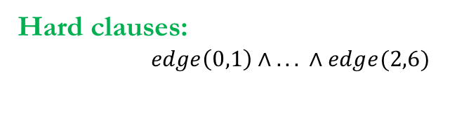
Example: Iteration 1 - Solve
Input relations:
edge(x, y)
Output relations:
path(x, y)
Hard constraints:
path(x, x).
path(x, z) :- path(x, y), edge(y, z).
Soft constraints:
¬ path(x, y). weight 1.5
Hard clauses:
$edge\left(0,1\right)∧$ $. . . ∧edge(2,6)$
Soft clauses:

Slide 95
Example: Iteration 1 - Check
Input relations:
edge(x, y)
Output relations:
path(x, y)
Hard constraints:
path(x, x).
path(x, z) :- path(x, y), edge(y, z).
Soft constraints:
¬ path(x, y). weight 1.5
Hard clauses:
$edge\left(0,1\right)∧$ $. . . ∧edge(2,6)$
Soft clauses:

Slide 96
Example: Iteration 2 - Solve
Input relations:
edge(x, y)
Output relations:
path(x, y)
Hard constraints:
path(x, x).
path(x, z) :- path(x, y), edge(y, z).
Soft constraints:
¬ path(x, y). weight 1.5
Hard clauses:
$$edge\left(0,1\right)∧ . . . ∧edge(2,6)∧$$
$path\left(0,0\right)∧$ $. . . ∧path(6,6)$
Soft clauses:

Slide 97
Example: Iteration 2 - Check
Input relations:
edge(x, y)
Output relations:
path(x, y)
Hard constraints:
path(x, x).
path(x, z) :- path(x, y), edge(y, z).
Soft constraints:
¬ path(x, y). weight 1.5
Hard clauses:
$$edge\left(0,1\right)∧ . . . ∧edge(2,6)∧$$
$path\left(0,0\right)∧$ $. . . ∧path(6,6)$
Soft clauses:

Slide 98
Example: Iteration 3 - Solve
Input relations:
edge(x, y)
Output relations:
path(x, y)
Hard constraints:
path(x, x).
path(x, z) :- path(x, y), edge(y, z).
Soft constraints:
¬ path(x, y). weight 1.5
Hard clauses:
$$edge\left(0,1\right)∧ . . . ∧edge(2,6)∧$$
$path\left(0,0\right)∧$ $. . . ∧path(6,6)∧$
$$path(0, \text{1}\text{)}∨¬path(0, \text{0}\text{)}∨¬edge\left(0, 1\right)∧$$
$$path(0, \text{2}\text{)}∨¬path(0, \text{0}\text{)}∨¬edge\left(0, 2\right)∧$$
... $∧ path(2, \text{6}\text{)}∨¬path(2, \text{2}\text{)}∨¬edge\left(2, 6\right)$
Soft clauses:
$(¬path\left(0,0\right) \text{weight}\text{ 1.5}$) $∧$
... $∧$
$(¬path\left(6,6\right) \text{weight}\text{ 1.5}$)

Slide 99
Example: Iteration 3 - Check
Input relations:
edge(x, y)
Output relations:
path(x, y)
Hard constraints:
path(x, x).
path(x, z) :- path(x, y), edge(y, z).
Soft constraints:
¬ path(x, y). weight 1.5
Hard clauses:
$$edge\left(0,1\right)∧ . . . ∧edge(2,6)∧$$
$path\left(0,0\right)∧$ $. . . ∧path(6,6)∧$
$$path(0, \text{1}\text{)}∨¬path(0, \text{0}\text{)}∨¬edge\left(0, 1\right)∧$$
$$path(0, \text{2}\text{)}∨¬path(0, \text{0}\text{)}∨¬edge\left(0, 2\right)∧$$
... $∧ path(2, \text{6}\text{)}∨¬path(2, \text{2}\text{)}∨¬edge\left(2, 6\right)$
Soft clauses:
$(¬path\left(0,0\right) \text{weight}\text{ 1.5}$) $∧$
... $∧$
$(¬path\left(6,6\right) \text{weight}\text{ 1.5}$)

Slide 100
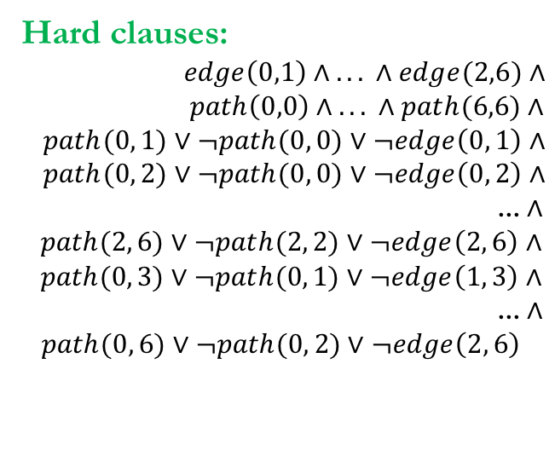
Example: Iteration 4 - Solve
Input relations:
edge(x, y)
Output relations:
path(x, y)
Hard constraints:
path(x, x).
path(x, z) :- path(x, y), edge(y, z).
Soft constraints:
¬ path(x, y). weight 1.5
Hard clauses:
$$edge\left(0,1\right)∧ . . . ∧edge(2,6)∧$$
$path\left(0,0\right)∧$ $. . . ∧path(6,6)∧$
$$path(0, \text{1}\text{)}∨¬path(0, \text{0}\text{)}∨¬edge\left(0, 1\right)∧$$
$$path(0, \text{2}\text{)}∨¬path(0, \text{0}\text{)}∨¬edge\left(0, 2\right)∧$$
... $∧$
$$path(2, \text{6}\text{)}∨¬path(2, \text{2}\text{)}∨¬edge\left(2, 6\right)∧$$
$$path(0, \text{3}\text{)}∨¬path(0, \text{1}\text{)}∨¬edge\left(1, 3\right)∧$$
... $∧$
$path(0, \text{6}\text{)}∨¬path(0, \text{2}\text{)}∨¬edge\left(2, 6\right)$
Soft clauses:
$(¬path\left(0,0\right) \text{weight}\text{ 1.5}$) $∧$
... $∧$
$(¬path\left(6,6\right) \text{weight}\text{ 1.5}$) $∧$
$(¬path\left(0,1\right) \text{weight}\text{ 1.5}$) $∧$
... $∧$
$(¬path\left(2,6\right) \text{weight}\text{ 1.5}$)

Slide 101
Example: Iteration 4 - Check
Input relations:
edge(x, y)
Output relations:
path(x, y)
Hard constraints:
path(x, x).
path(x, z) :- path(x, y), edge(y, z).
Soft constraints:
¬ path(x, y). weight 1.5
Hard clauses:
$$edge\left(0,1\right)∧ . . . ∧edge(2,6)∧$$
$path\left(0,0\right)∧$ $. . . ∧path(6,6)∧$
$$path(0, \text{1}\text{)}∨¬path(0, \text{0}\text{)}∨¬edge\left(0, 1\right)∧$$
$$path(0, \text{2}\text{)}∨¬path(0, \text{0}\text{)}∨¬edge\left(0, 2\right)∧$$
... $∧$
$$path(2, \text{6}\text{)}∨¬path(2, \text{2}\text{)}∨¬edge\left(2, 6\right)∧$$
$$path(0, \text{3}\text{)}∨¬path(0, \text{1}\text{)}∨¬edge\left(1, 3\right)∧$$
... $∧$
$path(0, \text{6}\text{)}∨¬path(0, \text{2}\text{)}∨¬edge\left(2, 6\right)$
Soft clauses:
$(¬path\left(0,0\right) \text{weight}\text{ 1.5}$) $∧$
... $∧$
$(¬path\left(6,6\right) \text{weight}\text{ 1.5}$) $∧$
$(¬path\left(0,1\right) \text{weight}\text{ 1.5}$) $∧$
... $∧$
$(¬path\left(2,6\right) \text{weight}\text{ 1.5}$)

Slide 102
Example: Iteration 5 - Solve
Input relations:
edge(x, y)
Output relations:
path(x, y)
Hard constraints:
path(x, x).
path(x, z) :- path(x, y), edge(y, z).
Soft constraints:
¬ path(x, y). weight 1.5
Hard clauses:
$$edge\left(0,1\right)∧ . . . ∧edge(2,6)∧$$
$path\left(0,0\right)∧$ $. . . ∧path(6,6)∧$
$$path(0, \text{1}\text{)}∨¬path(0, \text{0}\text{)}∨¬edge\left(0, 1\right)∧$$
$$path(0, \text{2}\text{)}∨¬path(0, \text{0}\text{)}∨¬edge\left(0, 2\right)∧$$
... $∧$
$$path(2, \text{6}\text{)}∨¬path(2, \text{2}\text{)}∨¬edge\left(2, 6\right)∧$$
$$path(0, \text{3}\text{)}∨¬path(0, \text{1}\text{)}∨¬edge\left(1, 3\right)∧$$
... $∧$
$path(0, \text{6}\text{)}∨¬path(0, \text{2}\text{)}∨¬edge\left(2, 6\right)$
Soft clauses:
$(¬path\left(0,0\right) \text{weight}\text{ 1.5}$) $∧$
... $∧$
$(¬path\left(6,6\right) \text{weight}\text{ 1.5}$) $∧$
$(¬path\left(0,1\right) \text{weight}\text{ 1.5}$) $∧$
... $∧$
$(¬path\left(2,6\right) \text{weight}\text{ 1.5}$) $∧ (¬path\left(0,3\right) \text{weight}\text{ 1.5}$) $∧$
... $∧$
$(¬path\left(0,6\right) \text{weight}\text{ 1.5}$)

Slide 103
Example: Iteration 5 - Check
1) All hard constraints are satisfied
2) No new violated soft constraints
=> sound to terminate
Hard clauses:
$$edge\left(0,1\right)∧ . . . ∧edge(2,6)∧$$
$path\left(0,0\right)∧$ $. . . ∧path(6,6)∧$
$$path(0, \text{1}\text{)}∨¬path(0, \text{0}\text{)}∨¬edge\left(0, 1\right)∧$$
$$path(0, \text{2}\text{)}∨¬path(0, \text{0}\text{)}∨¬edge\left(0, 2\right)∧$$
... $∧$
$$path(2, \text{6}\text{)}∨¬path(2, \text{2}\text{)}∨¬edge\left(2, 6\right)∧$$
$$path(0, \text{3}\text{)}∨¬path(0, \text{1}\text{)}∨¬edge\left(1, 3\right)∧$$
... $∧$
$path(0, \text{6}\text{)}∨¬path(0, \text{2}\text{)}∨¬edge\left(2, 6\right)$
Input relations:
edge(x, y)
Output relations:
path(x, y)
Hard constraints:
path(x, x).
path(x, z) :- path(x, y), edge(y, z).
Soft constraints:
¬ path(x, y). weight 1.5
Soft clauses:
$(¬path\left(0,0\right) \text{weight}\text{ 1.5}$) $∧$
... $∧$
$(¬path\left(6,6\right) \text{weight}\text{ 1.5}$) $∧$
$(¬path\left(0,1\right) \text{weight}\text{ 1.5}$) $∧$
... $∧$
$(¬path\left(2,6\right) \text{weight}\text{ 1.5}$) $∧ (¬path\left(0,3\right) \text{weight}\text{ 1.5}$) $∧$
... $∧$
$(¬path\left(0,6\right) \text{weight}\text{ 1.5}$)

Slide 104
Horn-Guided Optimization
Input relations:
edge(x, y)
Output relations:
path(x, y)
Hard constraints:
path(x, x).
path(x, z) :- path(x, y), edge(y, z).
Soft constraints:
¬ path(x, y). weight 1.5
Horn Rules!
Preprocess hard Horn rules

Slide 105
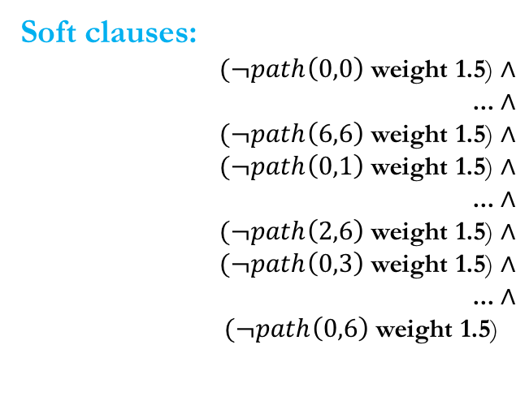
Horn-Guided Optimization
1) All hard constraints are satisfied
2) No new violated soft constraints
=> sound to terminate
Input relations:
edge(x, y)
Output relations:
path(x, y)
Hard constraints:
path(x, x).
path(x, z) :- path(x, y), edge(y, z).
Soft constraints:
¬ path(x, y). weight 1.5
Hard clauses:
Soft clauses:
$(¬path\left(0,0\right) \text{weight}\text{ 1.5}$) $∧$
... $∧$
$(¬path\left(6,6\right) \text{weight}\text{ 1.5}$) $∧$
$(¬path\left(0,1\right) \text{weight}\text{ 1.5}$) $∧$
... $∧$
$(¬path\left(2,6\right) \text{weight}\text{ 1.5}$) $∧$
$(¬path\left(0,3\right) \text{weight}\text{ 1.5}$) $∧$
... $∧$
$(¬path\left(0,6\right) \text{weight}\text{ 1.5}$)

Slide 106
Performance Evaluation
 | total # ground clauses
avrora | 1.8 x 10²⁶
ftp | 3.7 x 10²³
hedc | 1.9 x 10²⁴
luindex | 1.6 x 10²⁵
lusearch | 1.7 x 10²⁵
weblech | 4.4 x 10²⁴
# iterations
Lazy | Guided
492 | 12
463 | 5
354 | 6
481 | 7
429 | 6
416 | 6
total time (hours : mins)
Lazy | Guided
6:31 | 0:25
7:53 | 0:08
1:55 | 0:06
4:07 | 0:12
2:38 | 0:14
1:59 | 0:07
# ground clauses
Lazy | Guided
0.8M | 1.6M
1.2M | 1.4M
0.8M | 0.9M
0.6M | 1.1M
0.6M | 1.0M
0.6M | 0.9M
Notes:
// Datarace analysis scalability results

Slide 107
Overview of Techniques
General Framework [SAT 2015]
Bottom-Up Solving [AAAI 2016]
Top-Down Solving [POPL 2016]

Slide 108


Queries in Different Domains
Program Reasoning:
Information Retrieval:
Does variable head alias with variable tail on line 50 in Complex.java?
Is Dijkstra most likely an author of “Structured Programming”?
Notes:
In fact, the concept of queries is very common in various domains. For example, in program reasoning, a query can be the question asking, whether variable head aliases with variable tail on line 50 in Complex.java. In Information retrieval, a query can be the question aksing, whether dijstra is most likely an author of “structured programming”.
certain var, certain program point
Certain author, certain book

Slide 109
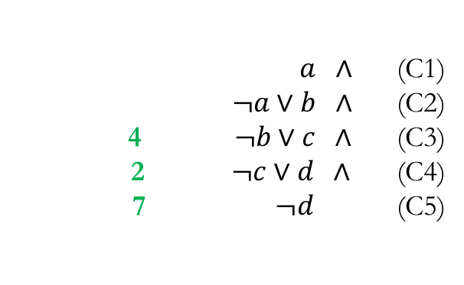
Queries in MaxSAT
$a ∧$(C1)
$¬a∨b ∧$(C2)
4 $¬b∨c ∧$(C3)
2 $¬c∨d ∧$ (C4)
7 $¬d$(C5)
QUERIES = {a, d}
Notes:
In the MaxSAT instances generated from such applications, the queries are mapped to the assignment to certain variables in the solution. And we also call such variables of interests queries. This allows us to define a new problem, called query-guided Maximum Satisfiability, or Q-MaxSAT

Slide 110
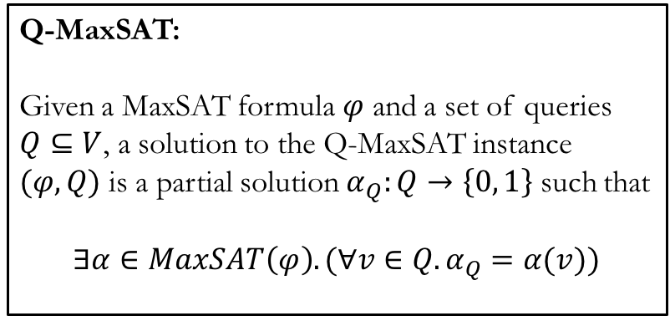
Query-Guided Maximum Satisfiability (Q-MaxSAT)
Q-MaxSAT:
Given a MaxSAT formula $φ$ and a set of queries $Q⊆V$, a solution to the Q-MaxSAT instance $(φ,Q)$ is a partial solution $α_{Q}:Q→\left\{0, 1\right\}$ such that
$$∃α∈MaxSAT\left(φ\right).(∀v∈Q. α_{Q}=α(v))$$
$a ∧$(C1)
$¬a∨b ∧$(C2)
4 $¬b∨c ∧$(C3)
2 $¬c∨d ∧$ (C4)
7 $¬d$(C5)
QUERIES = {a, d}
Notes:
Q-MaxSAT augments the MaxSAT problem with a set of queries. And a solution to the Q-MaxSAT instance is a partial solution to these queries, such that there exists a completion under the partial solution, which is a solution to the original MaxSAT problem.
One naïve way to solve the Q-MaxSAT problem is to feed the MaxSAT formula to a MaxSAT solver and extract the assignment to the queries. However, this will lose the whole point of being query-guided. We on the other hand, proposes an iterative algorithm, which only tries to solve the part that is relevant to the queries.

Slide 111
Query-Guided Maximum Satisfiability (Q-MaxSAT)
Q-MaxSAT:
Given a MaxSAT formula $φ$ and a set of queries $Q⊆V$, a solution to the Q-MaxSAT instance $(φ,Q)$ is a partial solution $α_{Q}:Q→\left\{0, 1\right\}$ such that
$$∃α∈MaxSAT\left(φ\right).(∀v∈Q. α_{Q}=α(v))$$
$a ∧$(C1)
$¬a∨b ∧$(C2)
4 $¬b∨c ∧$(C3)
2 $¬c∨d ∧$ (C4)
7 $¬d$(C5)
QUERIES = {a, d}
Solution: a = true, d = false
Notes:
Q-MaxSAT augments the MaxSAT problem with a set of queries. And a solution to the Q-MaxSAT instance is a partial solution to these queries, such that there exists a completion under the partial solution, which is a solution to the original MaxSAT problem.
One naïve way to solve the Q-MaxSAT problem is to feed the MaxSAT formula to a MaxSAT solver and extract the assignment to the queries. However, this will lose the whole point of being query-guided. We on the other hand, proposes an iterative algorithm, which only tries to solve the part that is relevant to the queries.

Slide 112
Query-Guided Maximum Satisfiability (Q-MaxSAT)
Q-MaxSAT:
Given a MaxSAT formula $φ$ and a set of queries $Q⊆V$, a solution to the Q-MaxSAT instance $(φ,Q)$ is a partial solution $α_{Q}:Q→\left\{0, 1\right\}$ such that
$$∃α∈MaxSAT\left(φ\right).(∀v∈Q. α_{Q}=α(v))$$
$a ∧$(C1)
$¬a∨b ∧$(C2)
4 $¬b∨c ∧$(C3)
2 $¬c∨d ∧$ (C4)
7 $¬d$(C5)
QUERIES = {a, d}
MaxSAT Solution: a = true, b = true, c = true, d = false
Notes:
Q-MaxSAT augments the MaxSAT problem with a set of queries. And a solution to the Q-MaxSAT instance is a partial solution to these queries, such that there exists a completion under the partial solution, which is a solution to the original MaxSAT problem.
One naïve way to solve the Q-MaxSAT problem is to feed the MaxSAT formula to a MaxSAT solver and extract the assignment to the queries. However, this will lose the whole point of being query-guided. We on the other hand, proposes an iterative algorithm, which only tries to solve the part that is relevant to the queries.

Slide 113
Our key idea:
Use a small set of clauses to succinctly summarize effect of unexplored clauses
Notes:
Our key idea is to use …..

Slide 114
Example
Queries = {v6}, formula =
v4 weight 100 ∧
v8 weight 100 ∧
¬ v7 weight 100 ∧
¬ v3 ∨ v1 weight 5 ∧
¬ v5 ∨ v2 weight 5 ∧
¬ v5 ∨ v3 weight 5 ∧
¬ v6 ∨ v5 weight 5 ∧
¬ v6 ∨ v7 weight 5 ∧
¬ v4 ∨ v6 weight 5 ∧
¬ v8 ∨ v6 weight 5 ∧
...
Notes:
Next, we illustrate our idea using an example Q-MaxSAT instance.
Emphasize the formula is very large, such that it cannot be solved by using a MaxSAT solver directly.

Slide 115
Example
Queries = {v6}, formula =
v4 weight 100 ∧
v8 weight 100 ∧
¬ v7 weight 100 ∧
¬ v3 ∨ v1 weight 5 ∧
¬ v5 ∨ v2 weight 5 ∧
¬ v5 ∨ v3 weight 5 ∧
¬ v6 ∨ v5 weight 5 ∧
¬ v6 ∨ v7 weight 5 ∧
¬ v4 ∨ v6 weight 5 ∧
¬ v8 ∨ v6 weight 5 ∧
...

Slide 116
Example
Queries = {v6}, formula =
v4 weight 100 ∧
v8 weight 100 ∧
¬ v7 weight 100 ∧
¬ v3 ∨ v1 weight 5 ∧
¬ v5 ∨ v2 weight 5 ∧
¬ v5 ∨ v3 weight 5 ∧
¬ v6 ∨ v5 weight 5 ∧
¬ v6 ∨ v7 weight 5 ∧
¬ v4 ∨ v6 weight 5 ∧
¬ v8 ∨ v6 weight 5 ∧
...

Slide 117
Example
Queries = {v6}, formula =
v4 weight 100 ∧
v8 weight 100 ∧
¬ v7 weight 100 ∧
¬ v3 ∨ v1 weight 5 ∧
¬ v5 ∨ v2 weight 5 ∧
¬ v5 ∨ v3 weight 5 ∧
¬ v6 ∨ v5 weight 5 ∧
¬ v6 ∨ v7 weight 5 ∧
¬ v4 ∨ v6 weight 5 ∧
¬ v8 ∨ v6 weight 5 ∧
...
Notes:
Graph:
Node -> variable
We represent each unit clauses by filling the related node with a T or F.
For example, for clause
Were repsent each implication clause by a directed edge.
For example,
The dotted area represents a large number of clauses we omit on the slide.

Slide 118
Example
Queries = {v6}, formula =
v4 weight 100 ∧
v8 weight 100 ∧
¬ v7 weight 100 ∧
¬ v3 ∨ v1 weight 5 ∧
¬ v5 ∨ v2 weight 5 ∧
¬ v5 ∨ v3 weight 5 ∧
¬ v6 ∨ v5 weight 5 ∧
¬ v6 ∨ v7 weight 5 ∧
¬ v4 ∨ v6 weight 5 ∧
¬ v8 ∨ v6 weight 5 ∧
...

Slide 119
Example
Queries = {v6}, formula =
v4 weight 100 ∧
v8 weight 100 ∧
¬ v7 weight 100 ∧
¬ v3 ∨ v1 weight 5 ∧
¬ v5 ∨ v2 weight 5 ∧
¬ v5 ∨ v3 weight 5 ∧
¬ v6 ∨ v5 weight 5 ∧
¬ v6 ∨ v7 weight 5 ∧
¬ v4 ∨ v6 weight 5 ∧
¬ v8 ∨ v6 weight 5 ∧
...

Slide 120
Example
Queries = {v6}, formula =
v4 weight 100 ∧
v8 weight 100 ∧
¬ v7 weight 100 ∧
¬ v3 ∨ v1 weight 5 ∧
¬ v5 ∨ v2 weight 5 ∧
¬ v5 ∨ v3 weight 5 ∧
¬ v6 ∨ v5 weight 5 ∧
¬ v6 ∨ v7 weight 5 ∧
¬ v4 ∨ v6 weight 5 ∧
¬ v8 ∨ v6 weight 5 ∧
...

Slide 121
Example: Iteration 1
Queries = {v6}, formula =
v4 weight 100 ∧
v8 weight 100 ∧
¬ v7 weight 100 ∧
¬ v3 ∨ v1 weight 5 ∧
¬ v5 ∨ v2 weight 5 ∧
¬ v5 ∨ v3 weight 5 ∧
¬ v6 ∨ v5 weight 5 ∧
¬ v6 ∨ v7 weight 5 ∧
¬ v4 ∨ v6 weight 5 ∧
¬ v8 ∨ v6 weight 5 ∧
...
workSet
Notes:
Our algorithm constructs the initial workset \phi’ by taking all the clauses containing v6, and feed it to a MaxSAT solver.

Slide 122
Example: Iteration 1 (blue = true, red = false)
Queries = {v6}, formula =
v4 weight 100 ∧
v8 weight 100 ∧
¬ v7 weight 100 ∧
¬ v3 ∨ v1 weight 5 ∧
¬ v5 ∨ v2 weight 5 ∧
¬ v5 ∨ v3 weight 5 ∧
¬ v6 ∨ v5 weight 5 ∧
¬ v6 ∨ v7 weight 5 ∧
¬ v4 ∨ v6 weight 5 ∧
¬ v8 ∨ v6 weight 5 ∧
...
workSet
Notes:
The MaxSAT solver produces a solution that assigns false to variables ranging from v4 to v8.

Slide 123
Example: Iteration 1 (blue = true, red = false)
?
Queries = {v6}, formula =
v4 weight 100 ∧
v8 weight 100 ∧
¬ v7 weight 100 ∧
¬ v3 ∨ v1 weight 5 ∧
¬ v5 ∨ v2 weight 5 ∧
¬ v5 ∨ v3 weight 5 ∧
¬ v6 ∨ v5 weight 5 ∧
¬ v6 ∨ v7 weight 5 ∧
¬ v4 ∨ v6 weight 5 ∧
¬ v8 ∨ v6 weight 5 ∧
...
workSet
Notes:
The MaxSAT solver produces a solution that assigns false to variables ranging from v4 to v8.

Slide 124
Example: Iteration 1 (blue = true, red = false)
?
Queries = {v6}, formula =
v4 weight 100 ∧
v8 weight 100 ∧
¬ v7 weight 100 ∧
¬ v3 ∨ v1 weight 5 ∧
¬ v5 ∨ v2 weight 5 ∧
¬ v5 ∨ v3 weight 5 ∧
¬ v6 ∨ v5 weight 5 ∧
¬ v6 ∨ v7 weight 5 ∧
¬ v4 ∨ v6 weight 5 ∧
¬ v8 ∨ v6 weight 5 ∧
...
workSet
frontiers
Notes:
Our observation is that, the clauses outside phi’ can only affect the query assignment via the clauses sharing variables in phi’. We call such clauses frontier clauses, which are marked on the slides.
Furthermore, if a partial clause is already satisfied by the current partial solution, including it in the current work set won’t improve the solution.

Slide 125
Example: Iteration 1 (blue = true, red = false)
?
Queries = {v6}, formula =
v4 weight 100 ∧
v8 weight 100 ∧
¬ v7 weight 100 ∧
¬ v3 ∨ v1 weight 5 ∧
¬ v5 ∨ v2 weight 5 ∧
¬ v5 ∨ v3 weight 5 ∧
¬ v6 ∨ v5 weight 5 ∧
¬ v6 ∨ v7 weight 5 ∧
¬ v4 ∨ v6 weight 5 ∧
¬ v8 ∨ v6 weight 5 ∧
...
workSet
frontiers
Notes:
This leaves us with just two unit frontier clauses.

Slide 126
Example: Iteration 1 (blue = true, red = false)
?
Queries = {v6}, formula =
v4 weight 100 ∧
v8 weight 100 ∧
¬ v7 weight 100 ∧
¬ v3 ∨ v1 weight 5 ∧
¬ v5 ∨ v2 weight 5 ∧
¬ v5 ∨ v3 weight 5 ∧
¬ v6 ∨ v5 weight 5 ∧
¬ v6 ∨ v7 weight 5 ∧
¬ v4 ∨ v6 weight 5 ∧
¬ v8 ∨ v6 weight 5 ∧
...
workSet
frontiers
summarySet =
{(100, v4), (100, v8)}
Notes:
We take these two clauses and construct a summarization set \psi, which summarize the effects the clauses outside \phi’.

Slide 127
Example: Iteration 1 (blue = true, red = false)
Queries = {v6}, formula =
v4 weight 100 ∧
v8 weight 100 ∧
¬ v7 weight 100 ∧
¬ v3 ∨ v1 weight 5 ∧
¬ v5 ∨ v2 weight 5 ∧
¬ v5 ∨ v3 weight 5 ∧
¬ v6 ∨ v5 weight 5 ∧
¬ v6 ∨ v7 weight 5 ∧
¬ v4 ∨ v6 weight 5 ∧
¬ v8 ∨ v6 weight 5 ∧
...
workSet
frontiers
summarySet =
{(100, v4), (100, v8)}
20
?
220
max(workSet $∪$ summarySet) - max(workSet) = 0
Notes:
Then, our algorithm performs the optimality check by comparing the best objective of \phi’ union \psi and that of \phi’. The former has an objective of 220, while the latter only has an objective of 20.

Slide 128
Example: Iteration 1 (blue = true, red = false)
Queries = {v6}, formula =
v4 weight 100 ∧
v8 weight 100 ∧
¬ v7 weight 100 ∧
¬ v3 ∨ v1 weight 5 ∧
¬ v5 ∨ v2 weight 5 ∧
¬ v5 ∨ v3 weight 5 ∧
¬ v6 ∨ v5 weight 5 ∧
¬ v6 ∨ v7 weight 5 ∧
¬ v4 ∨ v6 weight 5 ∧
¬ v8 ∨ v6 weight 5 ∧
...
workSet
frontiers
summarySet =
{(100, v4), (100, v8)}
20
220
✖
max(workSet $∪$ summarySet) - max(workSet) = 0
Notes:
As a result, we fail the optimality check.

Slide 129
Example: Iteration 1 (blue = true, red = false)
Queries = {v6}, formula =
v4 weight 100 ∧
v8 weight 100 ∧
¬ v7 weight 100 ∧
¬ v3 ∨ v1 weight 5 ∧
¬ v5 ∨ v2 weight 5 ∧
¬ v5 ∨ v3 weight 5 ∧
¬ v6 ∨ v5 weight 5 ∧
¬ v6 ∨ v7 weight 5 ∧
¬ v4 ∨ v6 weight 5 ∧
¬ v8 ∨ v6 weight 5 ∧
...
workSet
frontiers
summarySet =
{(100, v4), (100, v8)}
v4 = true, v5 = true, v6 = true, v7 = true, v8 = true
20
220
✖
max(workSet $∪$ summarySet) - max(workSet) = 0
Notes:
As a result, we fail the optimality check.

Slide 130
Example: Iteration 2 (blue = true, red = false)
Queries = {v6}, formula =
v4 weight 100 ∧
v8 weight 100 ∧
¬ v7 weight 100 ∧
¬ v3 ∨ v1 weight 5 ∧
¬ v5 ∨ v2 weight 5 ∧
¬ v5 ∨ v3 weight 5 ∧
¬ v6 ∨ v5 weight 5 ∧
¬ v6 ∨ v7 weight 5 ∧
¬ v4 ∨ v6 weight 5 ∧
¬ v8 ∨ v6 weight 5 ∧
...
workSet
Notes:
In the second iteration, by invoking the MaxSAT solver on phi’, we get a solution which assigns true to variables ranging from v4 to v8.

Slide 131
Example: Iteration 2 (blue = true, red = false)
?
Queries = {v6}, formula =
v4 weight 100 ∧
v8 weight 100 ∧
¬ v7 weight 100 ∧
¬ v3 ∨ v1 weight 5 ∧
¬ v5 ∨ v2 weight 5 ∧
¬ v5 ∨ v3 weight 5 ∧
¬ v6 ∨ v5 weight 5 ∧
¬ v6 ∨ v7 weight 5 ∧
¬ v4 ∨ v6 weight 5 ∧
¬ v8 ∨ v6 weight 5 ∧
...
workSet

Slide 132
Example: Iteration 2 (blue = true, red = false)
?
Queries = {v6}, formula =
v4 weight 100 ∧
v8 weight 100 ∧
¬ v7 weight 100 ∧
¬ v3 ∨ v1 weight 5 ∧
¬ v5 ∨ v2 weight 5 ∧
¬ v5 ∨ v3 weight 5 ∧
¬ v6 ∨ v5 weight 5 ∧
¬ v6 ∨ v7 weight 5 ∧
¬ v4 ∨ v6 weight 5 ∧
¬ v8 ∨ v6 weight 5 ∧
...
workSet
frontiers
summarySet = {(100, ¬v7),
(5, ¬v5∨v2), (5, ¬v5∨v3)}
Notes:
Similarly, to perform optimality check, we construct a summarization set by taking the frontier clauses that are not satisfied by the current partial solution.

Slide 133
Example: Iteration 2 (blue = true, red = false)
Queries = {v6}, formula =
v4 weight 100 ∧
v8 weight 100 ∧
¬ v7 weight 100 ∧
¬ v3 ∨ v1 weight 5 ∧
¬ v5 ∨ v2 weight 5 ∧
¬ v5 ∨ v3 weight 5 ∧
¬ v6 ∨ v5 weight 5 ∧
¬ v6 ∨ v7 weight 5 ∧
¬ v4 ∨ v6 weight 5 ∧
¬ v8 ∨ v6 weight 5 ∧
...
workSet
summarySet = {(100, ¬v7),
(5, ¬v5∨v2), (5, ¬v5∨v3)}
?
max(workSet $∪$ summarySet) - max(workSet) = 0
Notes:
However, if we want to perform a similar optimality check as last iteration, the check will trivially fail because of the two newly introduced variables, v2 and v3.
To solve the problem, and further improve the precision of our optimality check, we remove v2 and v3 from the summarization set, and strengthen the clauses in it.
In this case, this is equivalent to setting v2 and v3 to false.
Intuitively, by setting these variables to false, we are overestimating the effects of the unexplored clauses, by assuming these frontier clauses will not be satisfied by unexplored variables like v2 and v3.

Slide 134
Example: Iteration 2 (blue = true, red = false)
Queries = {v6}, formula =
v4 weight 100 ∧
v8 weight 100 ∧
¬ v7 weight 100 ∧
¬ v3 ∨ v1 weight 5 ∧
¬ v5 ∨ v2 weight 5 ∧
¬ v5 ∨ v3 weight 5 ∧
¬ v6 ∨ v5 weight 5 ∧
¬ v6 ∨ v7 weight 5 ∧
¬ v4 ∨ v6 weight 5 ∧
¬ v8 ∨ v6 weight 5 ∧
...
workSet
summarySet = {(100, ¬v7),
(5, ¬v5), (5, ¬v5)}
?
max(workSet $∪$ summarySet) - max(workSet) = 0
Notes:
With the new summarization set, we perform the check again

Slide 135
Example: Iteration 2 (blue = true, red = false)
Queries = {v6}, formula =
v4 weight 100 ∧
v8 weight 100 ∧
¬ v7 weight 100 ∧
¬ v3 ∨ v1 weight 5 ∧
¬ v5 ∨ v2 weight 5 ∧
¬ v5 ∨ v3 weight 5 ∧
¬ v6 ∨ v5 weight 5 ∧
¬ v6 ∨ v7 weight 5 ∧
¬ v4 ∨ v6 weight 5 ∧
¬ v8 ∨ v6 weight 5 ∧
...
workSet
summarySet = {(100, ¬v7),
(5, ¬v5), (5, ¬v5)}
220
320
max(workSet $∪$ summarySet) - max(workSet) = 0
✖
Notes:
Although the optimality check still fails, in next iteration, we will show our algorithm terminates by applying this improved check.

Slide 136
Example: Iteration 2 (blue = true, red = false)
Queries = {v6}, formula =
v4 weight 100 ∧
v8 weight 100 ∧
¬ v7 weight 100 ∧
¬ v3 ∨ v1 weight 5 ∧
¬ v5 ∨ v2 weight 5 ∧
¬ v5 ∨ v3 weight 5 ∧
¬ v6 ∨ v5 weight 5 ∧
¬ v6 ∨ v7 weight 5 ∧
¬ v4 ∨ v6 weight 5 ∧
¬ v8 ∨ v6 weight 5 ∧
...
workSet
summarySet = {(100, ¬v7),
(5, ¬v5), (5, ¬v5)}
220
v4 = true, v5 = false, v6 = true, v7 = true, v8 = true
320
max(workSet $∪$ summarySet) - max(workSet) = 0
✖
Notes:
Similarly, by checking the solution to \phi’ union psi, we conclude all three clauses in the summarization set are likely responsible for failing the check. Therefore, we expand the workset phi’ with their original clauses.

Slide 137
Example: Iteration 3 (blue = true, red = false)
Queries = {v6}, formula =
v4 weight 100 ∧
v8 weight 100 ∧
¬ v7 weight 100 ∧
¬ v3 ∨ v1 weight 5 ∧
¬ v5 ∨ v2 weight 5 ∧
¬ v5 ∨ v3 weight 5 ∧
¬ v6 ∨ v5 weight 5 ∧
¬ v6 ∨ v7 weight 5 ∧
¬ v4 ∨ v6 weight 5 ∧
¬ v8 ∨ v6 weight 5 ∧
...
workSet
Notes:
In the third iteration, we get a solution for phi’ that assigns true to variables ranging from v2 to v8.

Slide 138
Example: Iteration 3 (blue = true, red = false)
?
Queries = {v6}, formula =
v4 weight 100 ∧
v8 weight 100 ∧
¬ v7 weight 100 ∧
¬ v3 ∨ v1 weight 5 ∧
¬ v5 ∨ v2 weight 5 ∧
¬ v5 ∨ v3 weight 5 ∧
¬ v6 ∨ v5 weight 5 ∧
¬ v6 ∨ v7 weight 5 ∧
¬ v4 ∨ v6 weight 5 ∧
¬ v8 ∨ v6 weight 5 ∧
...
workSet
Notes:
To perform the optimality check,

Slide 139
Example: Iteration 3 (blue = true, red = false)
?
frontier
Queries = {v6}, formula =
v4 weight 100 ∧
v8 weight 100 ∧
¬ v7 weight 100 ∧
¬ v3 ∨ v1 weight 5 ∧
¬ v5 ∨ v2 weight 5 ∧
¬ v5 ∨ v3 weight 5 ∧
¬ v6 ∨ v5 weight 5 ∧
¬ v6 ∨ v7 weight 5 ∧
¬ v4 ∨ v6 weight 5 ∧
¬ v8 ∨ v6 weight 5 ∧
...
workSet
summarySet = {(5, ¬v3∨v1)}
Notes:
we construct the summarization set.
Similar to Iteration 2, we improve the optimality check by strengthening the frontier clauses.

Slide 140
Example: Iteration 3 (blue = true, red = false)
frontier
Queries = {v6}, formula =
v4 weight 100 ∧
v8 weight 100 ∧
¬ v7 weight 100 ∧
¬ v3 ∨ v1 weight 5 ∧
¬ v5 ∨ v2 weight 5 ∧
¬ v5 ∨ v3 weight 5 ∧
¬ v6 ∨ v5 weight 5 ∧
¬ v6 ∨ v7 weight 5 ∧
¬ v4 ∨ v6 weight 5 ∧
¬ v8 ∨ v6 weight 5 ∧
...
workSet
summarySet = {(5, ¬v3∨v1)}
325
330
max(workSet $∪$ summarySet) - max(workSet) = 0
✖
Notes:
This time, by performing the improvied optimaility check.

Slide 141
Example: Iteration 3 (blue = true, red = false)
frontier
Queries = {v6}, formula =
v4 weight 100 ∧
v8 weight 100 ∧
¬ v7 weight 100 ∧
¬ v3 ∨ v1 weight 5 ∧
¬ v5 ∨ v2 weight 5 ∧
¬ v5 ∨ v3 weight 5 ∧
¬ v6 ∨ v5 weight 5 ∧
¬ v6 ∨ v7 weight 5 ∧
¬ v4 ∨ v6 weight 5 ∧
¬ v8 ∨ v6 weight 5 ∧
...
workSet
summarySet = {(5, ¬v3∨v1)}
325
✓
325
max(workSet $∪$ summarySet) - max(workSet) = 0
Notes:
We succesfully conclude that v6=true is a solution to the q-maxsat problem.
Although there are many clauses and variables that can reach v6 in the graph, our approach manage to resolve v6 in just three iterations by only exploring a small part of the graph.

Slide 142
Example
Queries = {v6}, formula =
v4 weight 100 ∧
v8 weight 100 ∧
¬ v7 weight 100 ∧
¬ v3 ∨ v1 weight 5 ∧
¬ v5 ∨ v2 weight 5 ∧
¬ v5 ∨ v3 weight 5 ∧
¬ v6 ∨ v5 weight 5 ∧
¬ v6 ∨ v7 weight 5 ∧
¬ v4 ∨ v6 weight 5 ∧
¬ v8 ∨ v6 weight 5 ∧
...
workSet
= formula
Notes:
In worst case, we do have to explore the whole formula. But in practice, we find we do not have to.

Slide 143
Benchmark Characteristics
 | # queries | # variables | # clauses
ftp | 55 | 2.3M | 3M
hedc | 36 | 3.8M | 4.8M
weblech | 25 | 5.8M | 8.4M
lusearch | 248 | 7.8M | 10.9M
luindex | 109 | 8.5M | 11.9M
avrora | 151 | 11.7M | 16.3M
IE | 6 | 47K | 0.9M
ER | 25 | 3K | 4.8M
AR | 10 | 0.3M | 7.9M
K = thousands, M = millions

Slide 144
Performance Results
 | running time (seconds) |  | peak memory (MB) |  | # clauses (M=million)
 | current | baseline | current | baseline | current | baseline
ftp | 16 | 11 | 16 | 1,262 | 0.03M | 3.0M
hedc | 23 | 21 | 181 | 1,918 | 0.4M | 4.8M
weblech | 4 | timeout | 363 | timeout | 0.9M | 8.4M
lusearch | 115 | timeout | 659 | timeout | 1.5M | 10.9M
luindex | 169 | timeout | 944 | timeout | 2.2M | 11.9M
avrora | 178 | timeout | 1,095 | timeout | 2.6M | 16.3M
IE | 2 | 2,760 | 13 | 335 | 27K | 0.9M
ER | 13 | 2 | 6 | 44 | 9K | 4.8M
AE | 4 | timeout | 4 | timeout | 2K | 7.9M

Slide 145
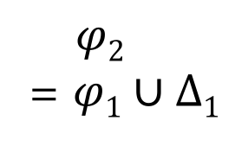
Incremental Solving [CP 2016]
…
$φ1$
Two levels of incrementality
MaxSAT level
Application solves a sequence of MaxSAT instances
Re-use unsat cores (for core-guided solver)
SAT level
Each MaxSAT solves a sequence of SAT instances
Leverage standard incremental SAT solving
Key insight: sporadic restarts
Heuristically detect and avoid reusing bad unsat cores based on split-limit (max. # times a soft clause is split)
$φ2$
= $φ1∪Δ1$
$φ3$
= $φ2∪Δ2$
Notes:
Re-use learned clauses (for solver with CDCL)

Slide 146
Performance Results
74 sequential MaxSAT problems (669 individual MaxSAT instances)

Slide 147



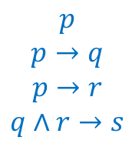
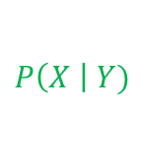
Future Directions
Humans In the Loop
Combining Logic With Probability
Program
Reasoning
Algorithm
$$p$$
$$p→q$$
$$p→r$$
$$q∧r→s$$
$$P\left(X \right| Y)$$
Optimization Solvers
Data-Driven
SMT
SAT
Datalog
MaxSAT
MaxSMT
Markov Logic Network
Probabilistic Soft Logic
…
Notes:
Our current work reveals four future research directions that we believe will change program reasoning techniques fundamentally. These four directions complement each other and our current work has only begun to reveal their potential.
The first direction is bringing human into the loop. Today’s techniques are either mostly automatic or mostly manual. However, I don’t believe either extreme is the right approach. For example, humans have domain knowledge and are very good at local reasoning, while automatic techniques are very good at handling tedious tasks and global reasoning. Therefore, the right approach should be an approach that systematically combines human capabilities and automatic techniques.
The second direction we’re investigating is to combine logical and probabilistic reasoning. Conventional program analyses have made great strides by leveraging logical reasoning. The logical approach provides many benefits. However, it cannot handle uncertainties very well, and lacks the ability to learn and adapt. On the other hand, the probabilistic approach doesn’t have these limitations. However, we don’t’ want to switch to a purely probabilistic approach because we want to keep the benefits of conventional program analysis. Therefore, the right approach should be a combined approach.
The third direction we’re investigating is optimization solvers. The constraint-based approach has emerged as a new computational paradigm in many fields of computer science. One example is the use of decision solvers, including SAT and Datalog solvers. Nowadays, researchers are trying to push forward the paradigm by investigating solvers with more expressiveness. One direction is to extend the current solvers to handle richer logic. One example of solvers that researchers are investigating is SMT solvers. Another direction that we’re investigating is to go from decision solvers to optimization solvers. In the future, we want both richer logic and the ability to express optimization objectives. One key challenge is how to develop efficient and accurate solving algorithms. One promising direction is to exploit domain knowledge.
The final direction we’re investigating is how to make program reasoning techniques data-driven. Currently, all conventional techniques depend mostly upon handcrafted knowledge. Why is this the case. There’re two reasons: 1there was not sufficient data availabel in the past. 2. all conventional approaches are based on logical reasoning, which is not effective at learning. But nowadays, we have a lot of open-source codebases and well-documented program errors and security vulnerabilities available. And researchers have started looking at how to incorporate probabilistic reasoning. These developments, taking together, lead me to believe there is a huge opportunity in improving the state of the art by levering data-driven approaches.

Slide 148



Conclusions
New methodology to incorporate objectives into constraint-based software analyses
Showed practical effectiveness for three dominant applications of software analyses
General framework to solve weighted constraints that is sound, optimal and scalable

